Slide 1
一站式产品
总图
产品（介绍+参数+图片）(一个产品两张ppt)

Slide 2
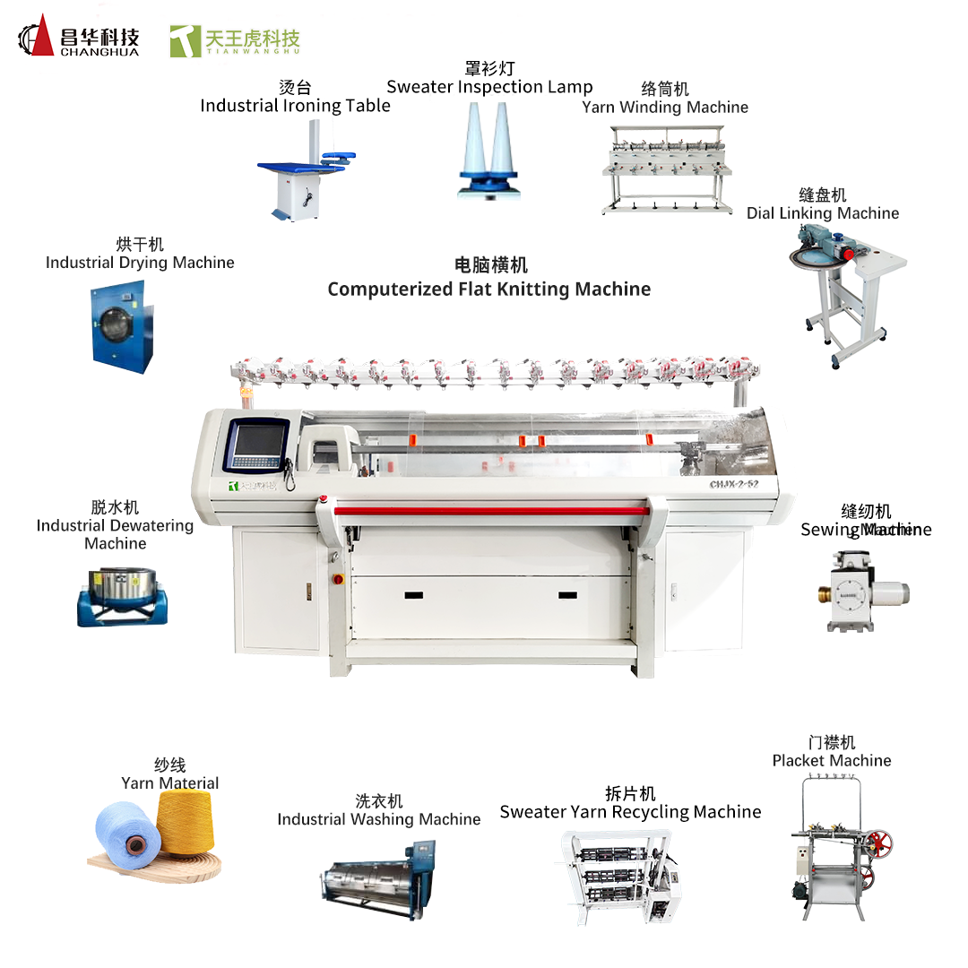
总图

Slide 3
产品1：络筒机-Yarn Winding Machine
BS-K9 Series Yarn Winding Machine Description
1. Vertical winder path with no inflection point little friction and less hairiness. It is appropriate or high-speed waxing winding. The speed of waxing is twice as much as that of traditional table type.
2. Using brushless DC motor with longer axis, it is convenient to adjust the speed of each unit spindle. Friendly define the speed of each spindle to apply for variety yarn.
3. Double points waxing system with micro motors, waxing steady and uniform. The forming of cheese is better.
4. Using high quality alloy drums with optimized groove shape, which has the advantages of good anti-overlapping characteristics, light weight good wear resistance and static elimination.
5. Single winding motor control for each spindle, electronic fixed-length, and single spindle automatic stop while yarn breakage or fully filled.
6. High speed creel with gas spring, which can keep constant winding pressure. This creel is stable and reliable.

Slide 4
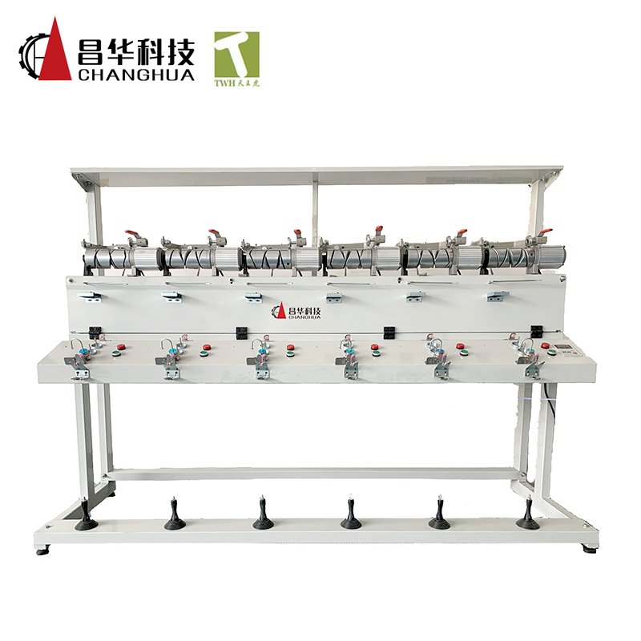
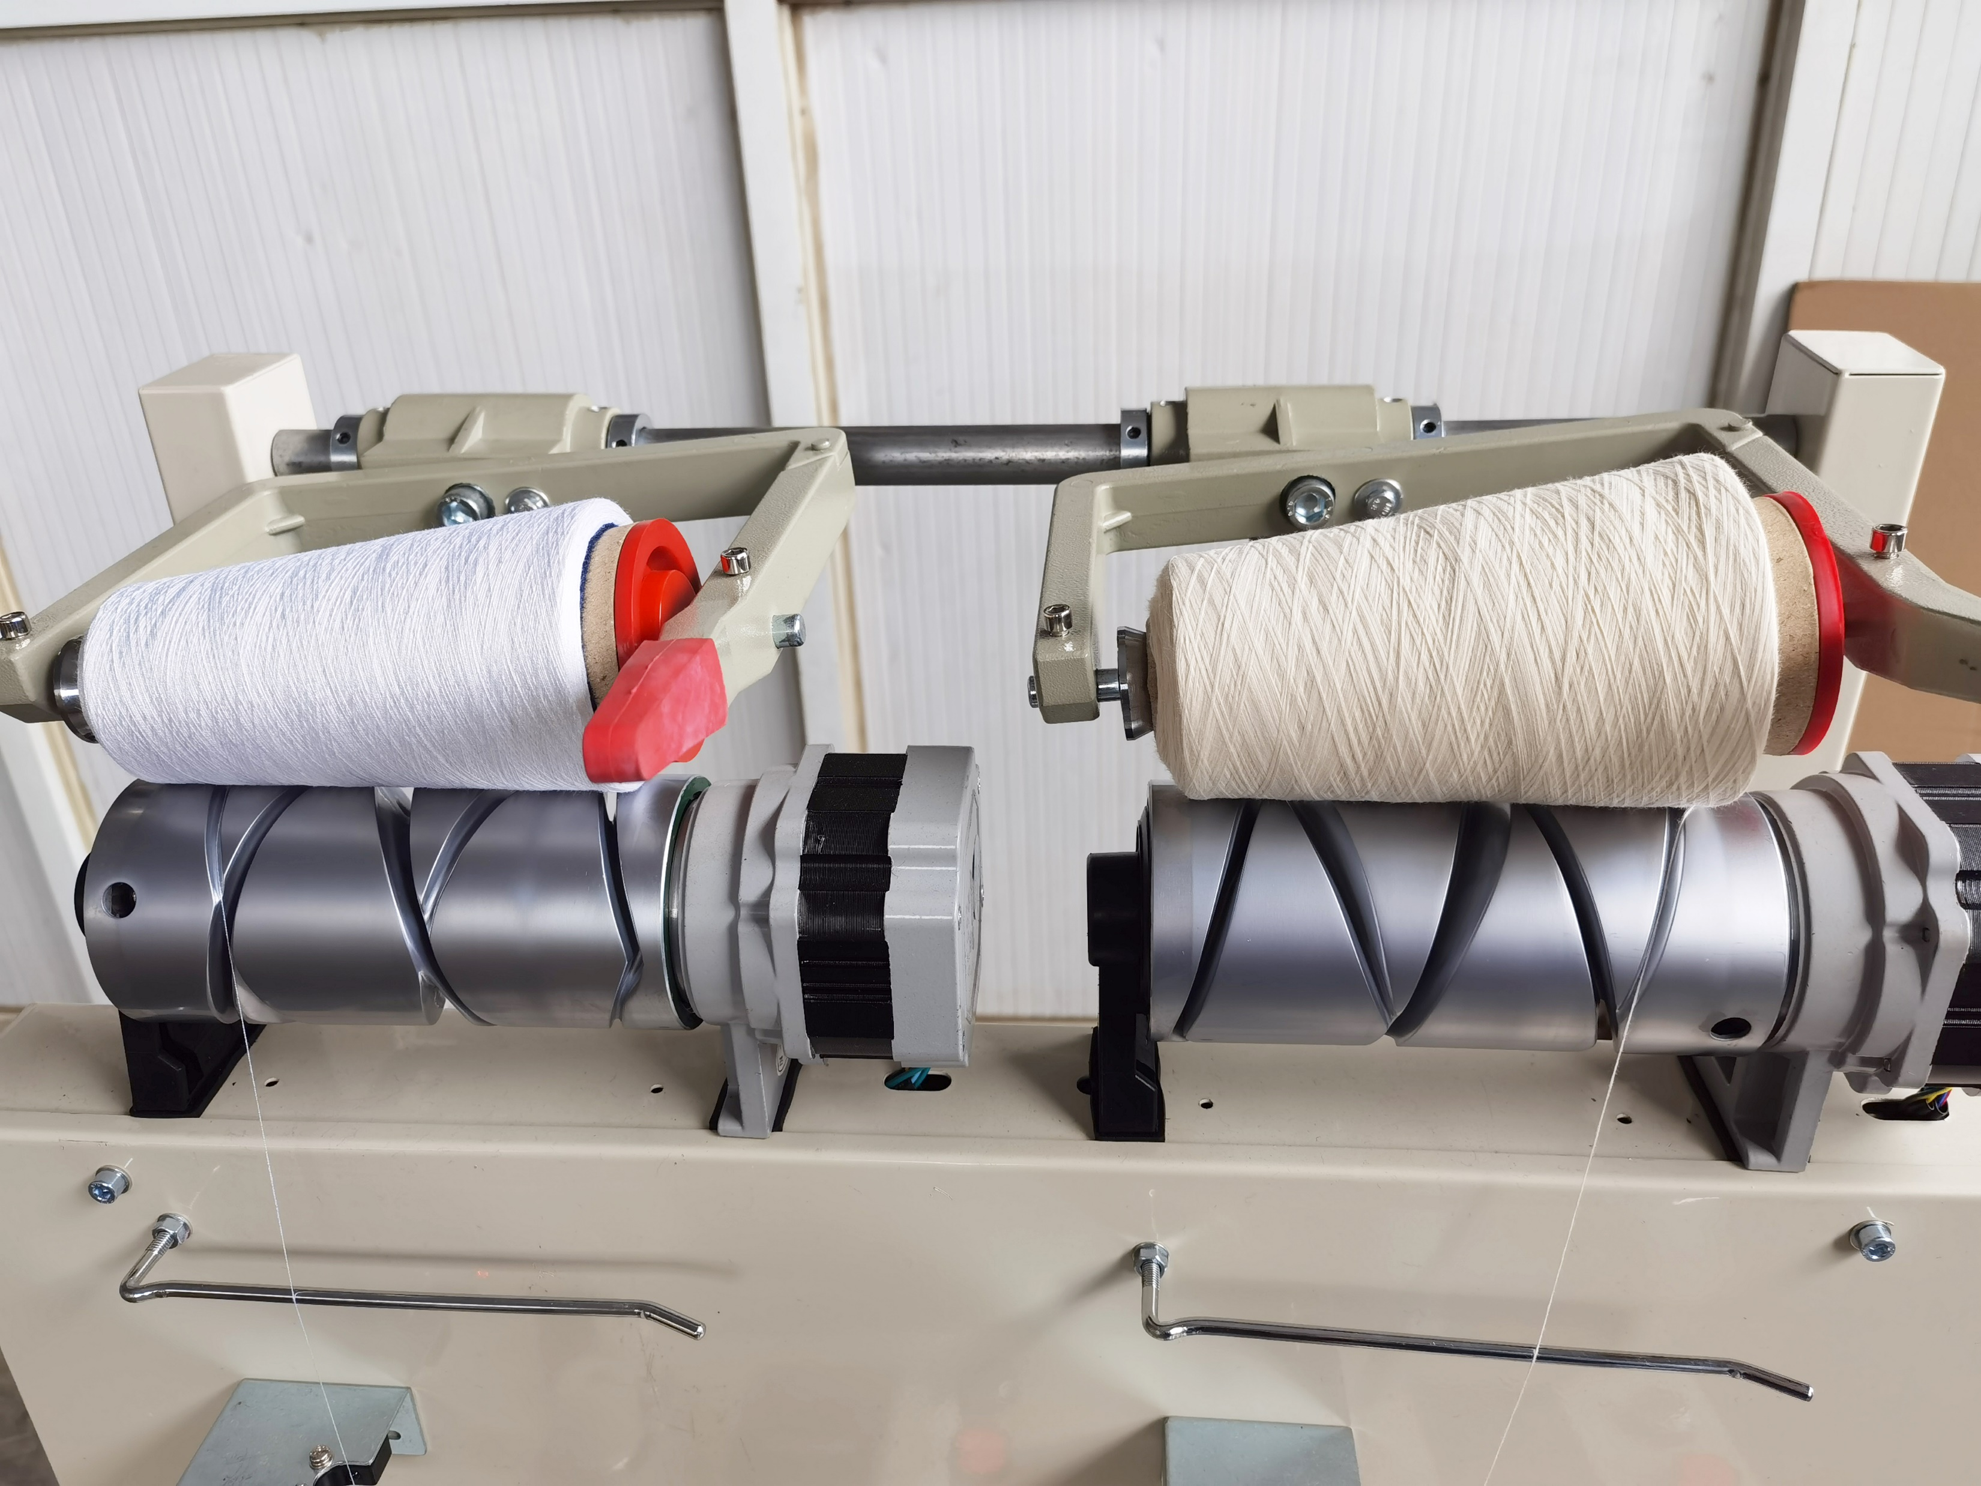
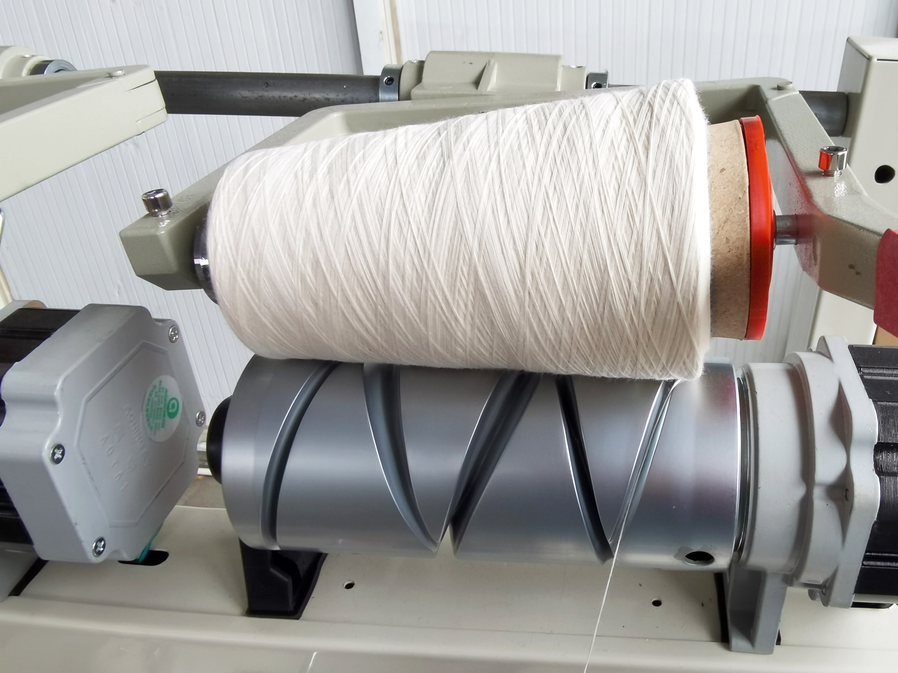
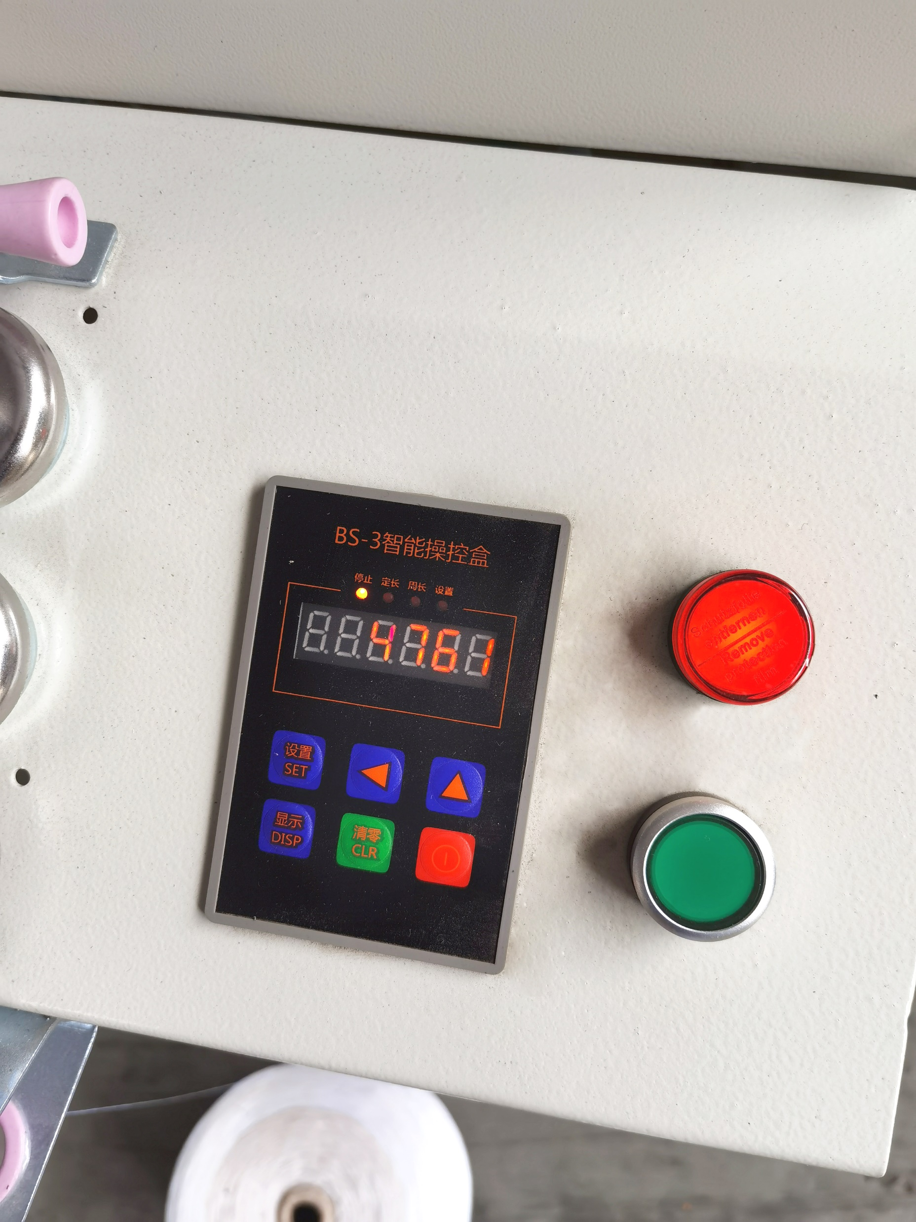
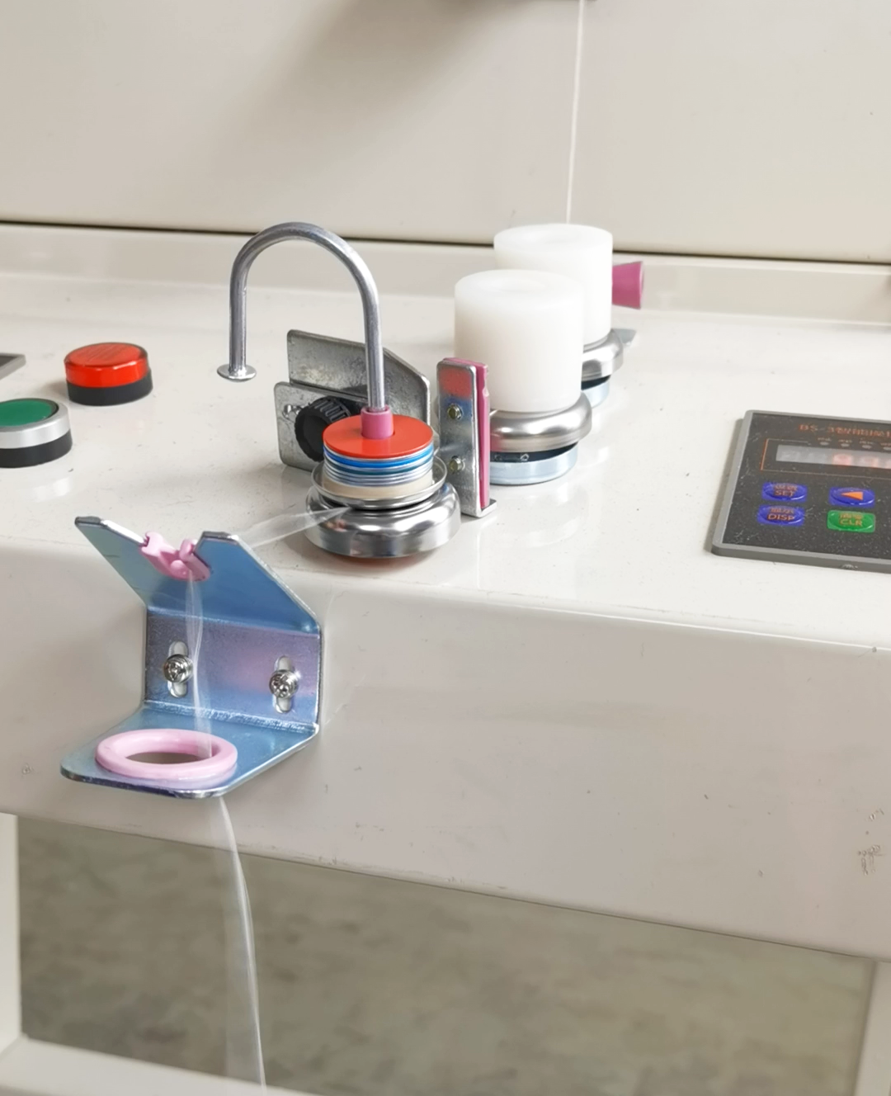
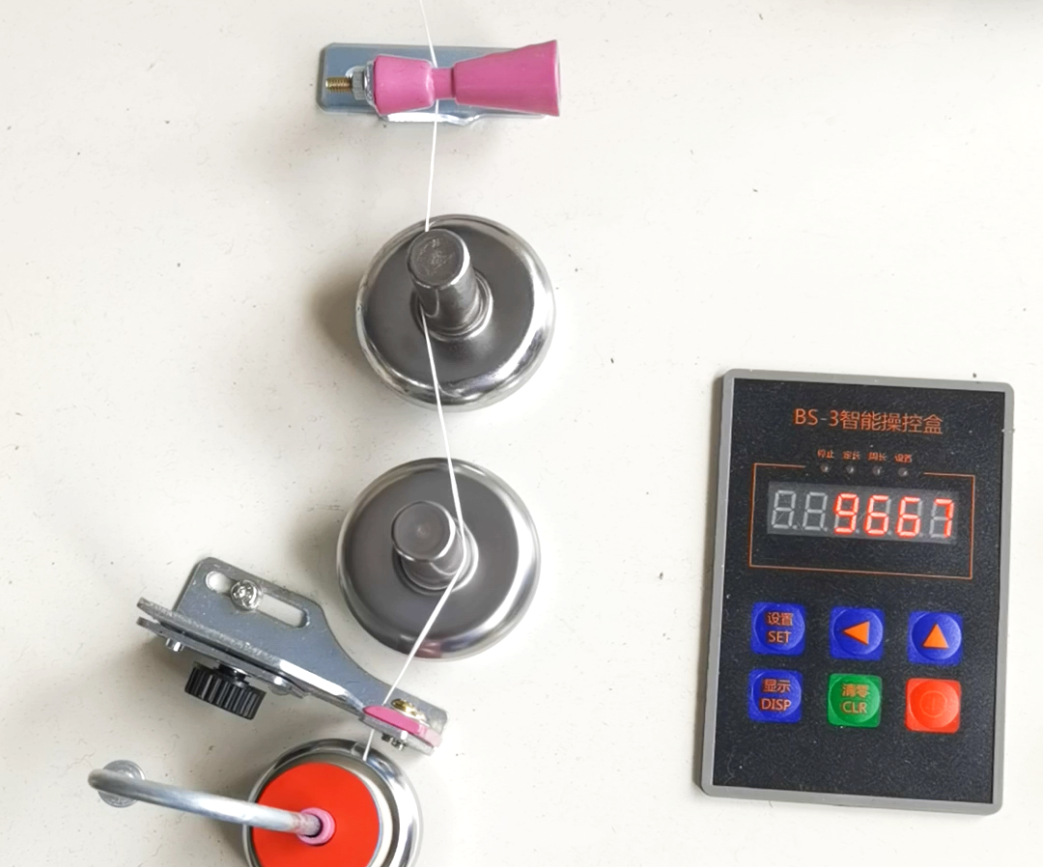
产品1：络筒机-Yarn Winding Machine
Type of Rewinding | Drum Random
Customized Spindle Number | 2/4/6/12/48/60/72 as order
Machine Speed | Up to 800m/minute
Package Shape | Cylindrical or conical
Traverse length | 150mm/ 152mm /154mm
Way of Anti-overlapping | By electronic
Package Bobbin | 0'/ 3°30”/420”/557”/915”
Package Density | Up to D290MM
Package Weight | 0.2-0.4G/CM3
Yarns /Count | Cotton, cashmere, wool, silk, fiber/NE6-180
Winding Capacity Per Cone | UP To 3Kgs
Gauge | 300mm
Machine layout | Vertical one sided /double sided
Driver Mode | DC Motor, adjustable and individual
Power Consumption | Install power 100W/Spindle, and 65W Consumed
Tension/Wax System | Yarn tension and waxing Device per spindle
Automatic Stop If Breakage | Automatic type
Length Fixing | Adjustable Max 999999m
Balance | The winding force can be control by balance of gas spring
Slow Start Mode | Available
Vacuum Dust Clearing System | Non | Yes | Non | Non | Non
Air Splicer | Option | Yes | Option | Option | Option
Hank Yarn Wheel | Non | Yes | Yes | Non | Non
Dimensions | 2 Spindle L730*W710*H1500mm 4 Spindle: L1390*W710*H1500mm 6Spindle L2050*W710*H1510 mm 12 Spindle L2050*W1450*H1510 mm
Weight | 2 Spindle: 55kgs 4 Spindle: 100 Kgs 6 Spindle: 155Kgs 12 Spindle: 295Kgs
Rated Power | Single phase 220V 50/60HZ
Power Consumption | 52inch:2480*800*1700mm (bare pager) 2970*940*1900mm (wooden case)

Slide 5
产品2：缝盘机-Dial Linking Machine
1. It adopts a cam connecting rod structure, which is compact, convenient, stable and reliable.
2. The big wheel, the "heart" of the sewing machine, adopts advanced technology and precise special equipment. The products produced have high stability, low noise, better performance than similar products, and stronger competitiveness.
3. When the operator hangs the film, the roller type push wheel can automatically push the wool piece to the bottom of the needle tooth, and at the same time, the wool piece thread that is not hooked into the needle tooth automatically rolls into the needle tooth, avoiding the operator’s finger injury and increasing the speed The effect of complete feeding is achieved, and the stitching line is more beautiful.
4. The world's only patented structure for loose yarn, allowing the industry to process more complex garments, leading the pack.
5. The large needles and needle teeth of this machine are all imported from Japan, with stronger strength and toughness.
6. The bearing is made of high-wave carbon steel and imported from abroad with superior performance.
7. The black pressure needle plate can prevent dust from entering the guide rail and at the same time prevent the light from hurting the eyes.
8. The 3H baking varnish of the same level as the car is not easy to be scratched, and is resistant to wear and durability.9. The assembly line processing procedures and strict quality assurance system make our product quality the most reliable.

Slide 6
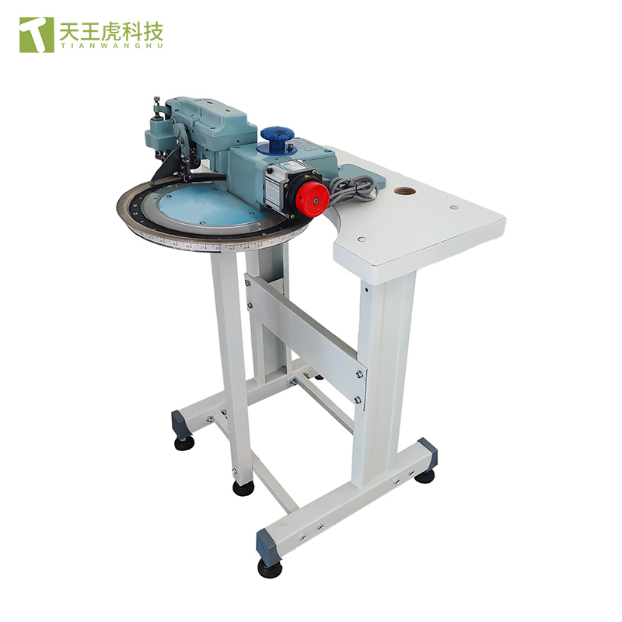
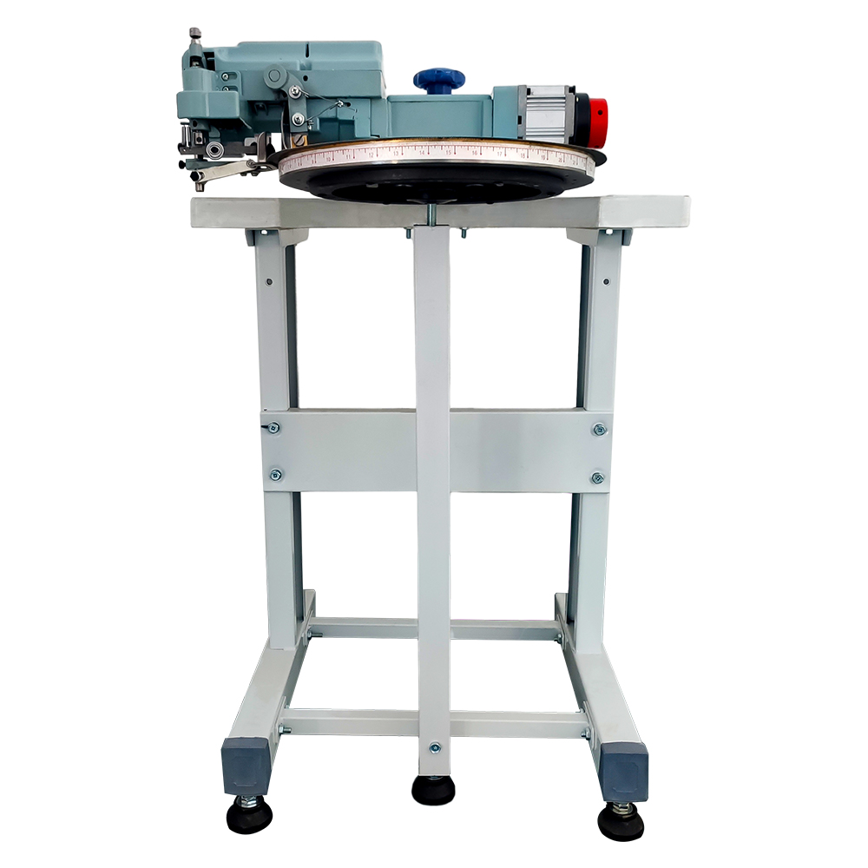
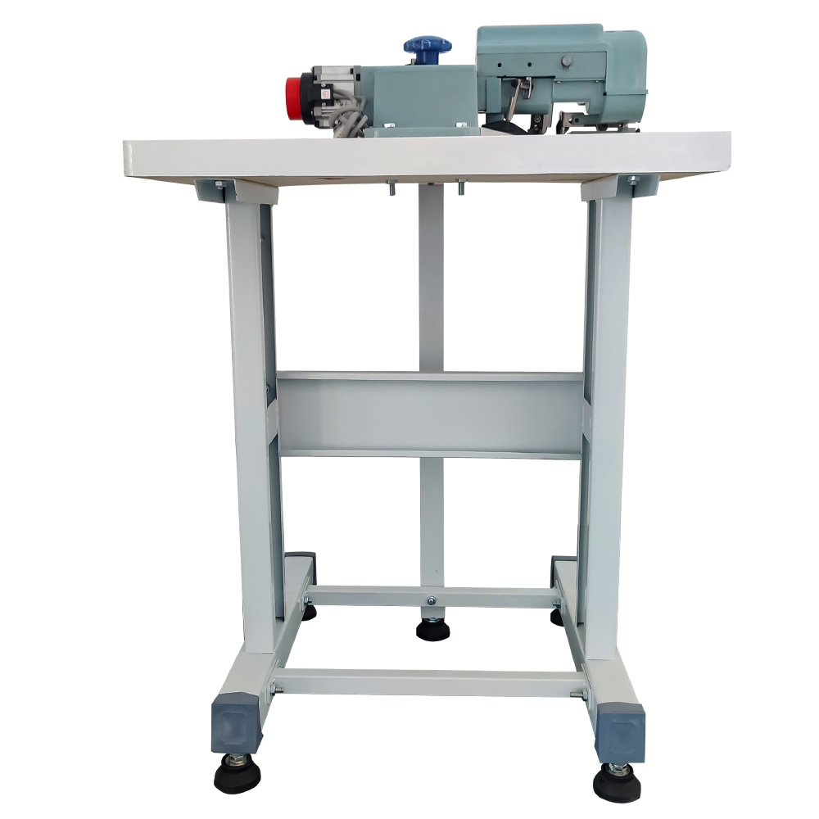
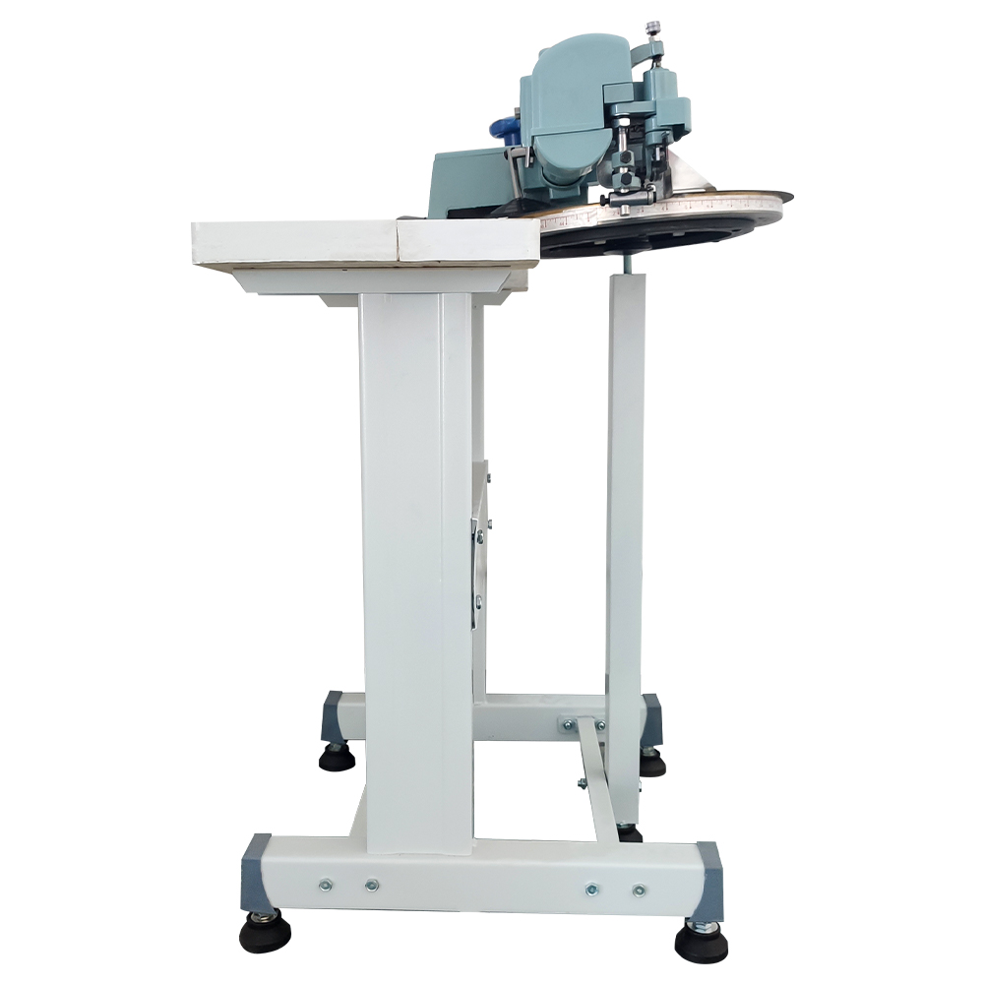
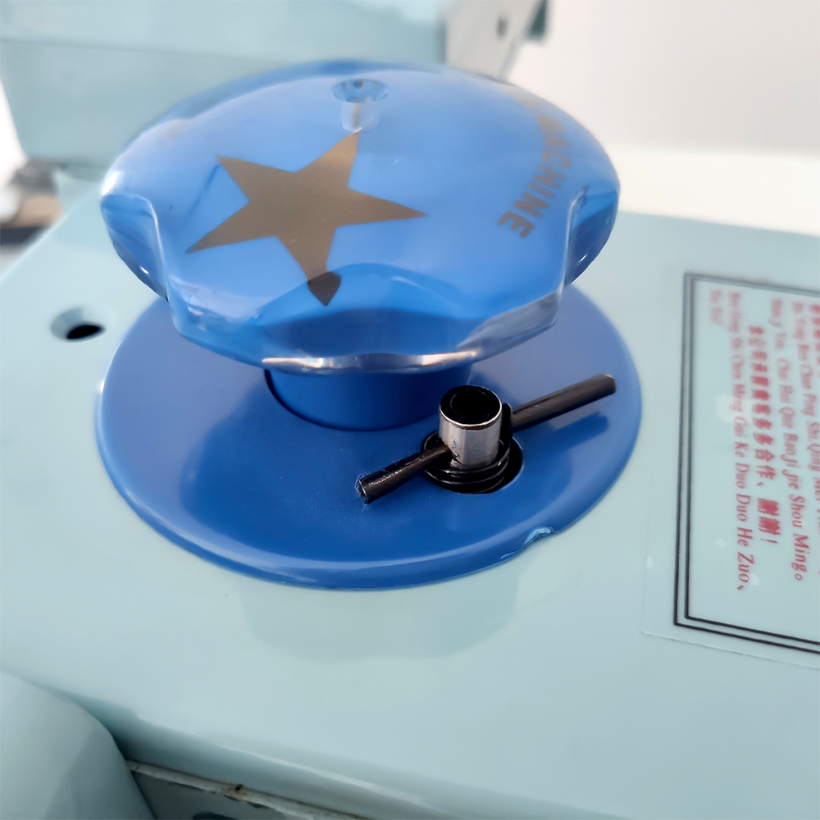
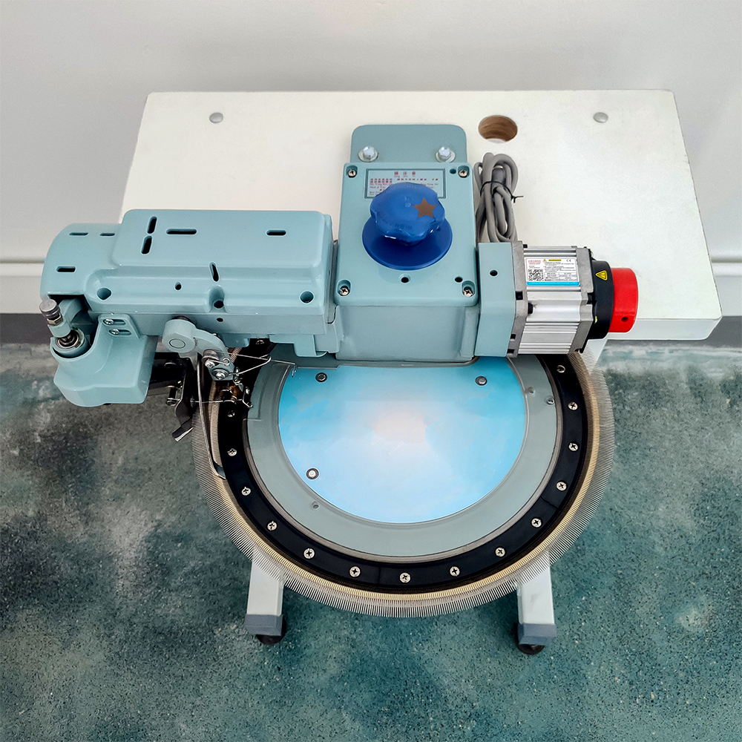
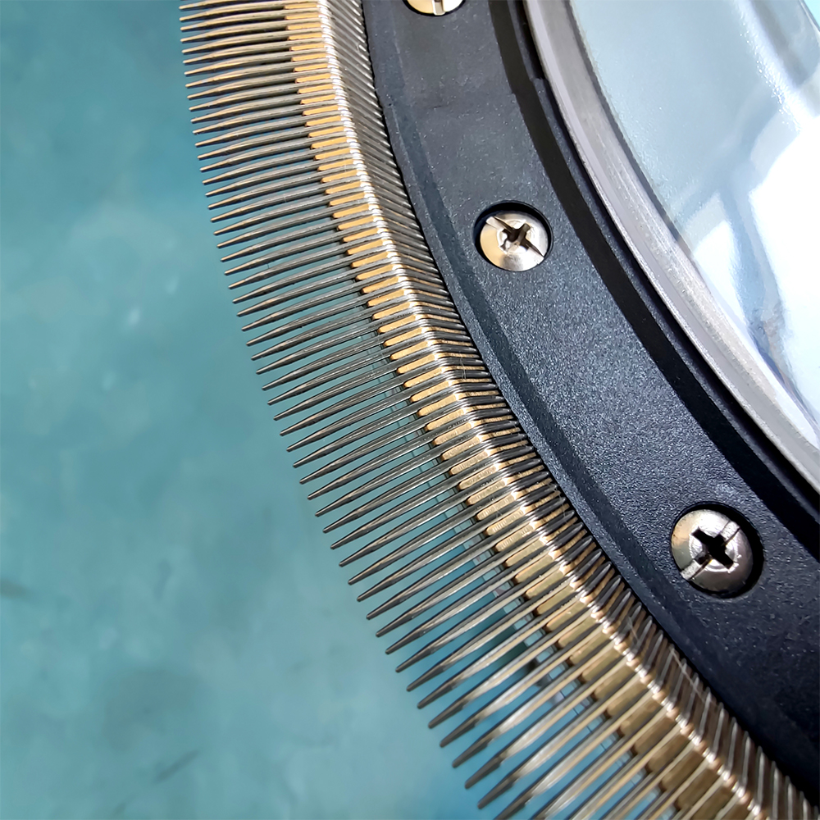
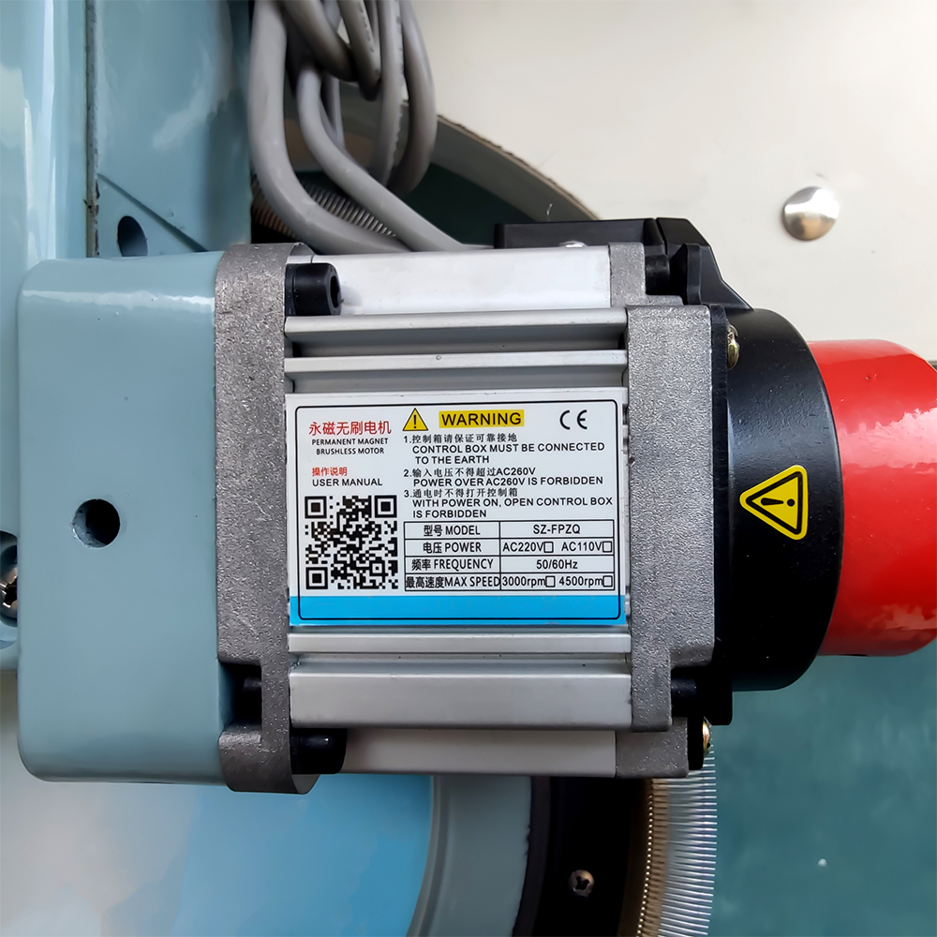
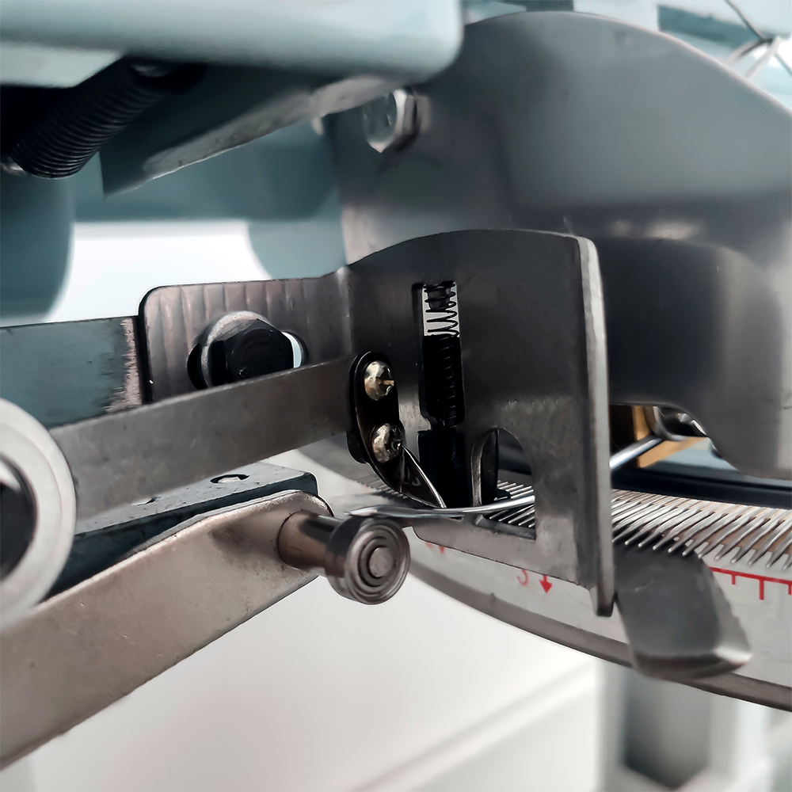
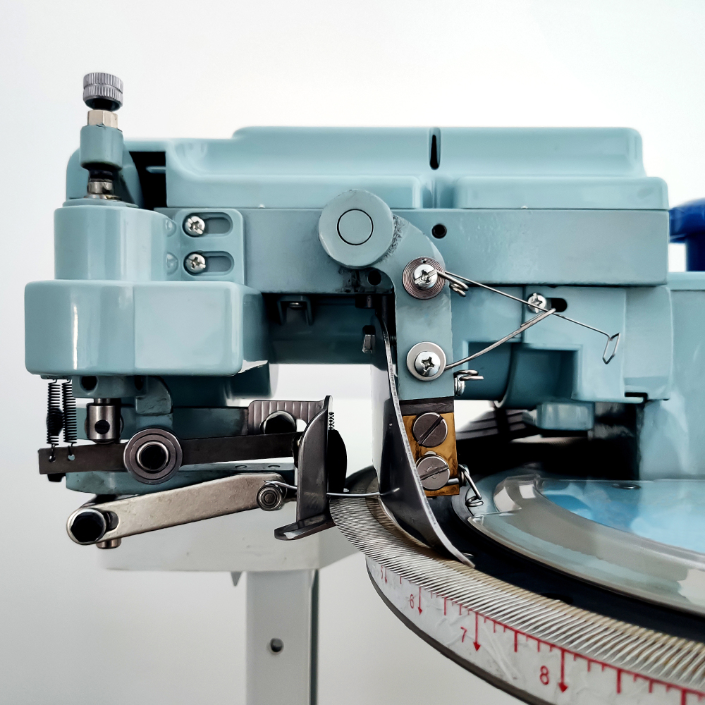
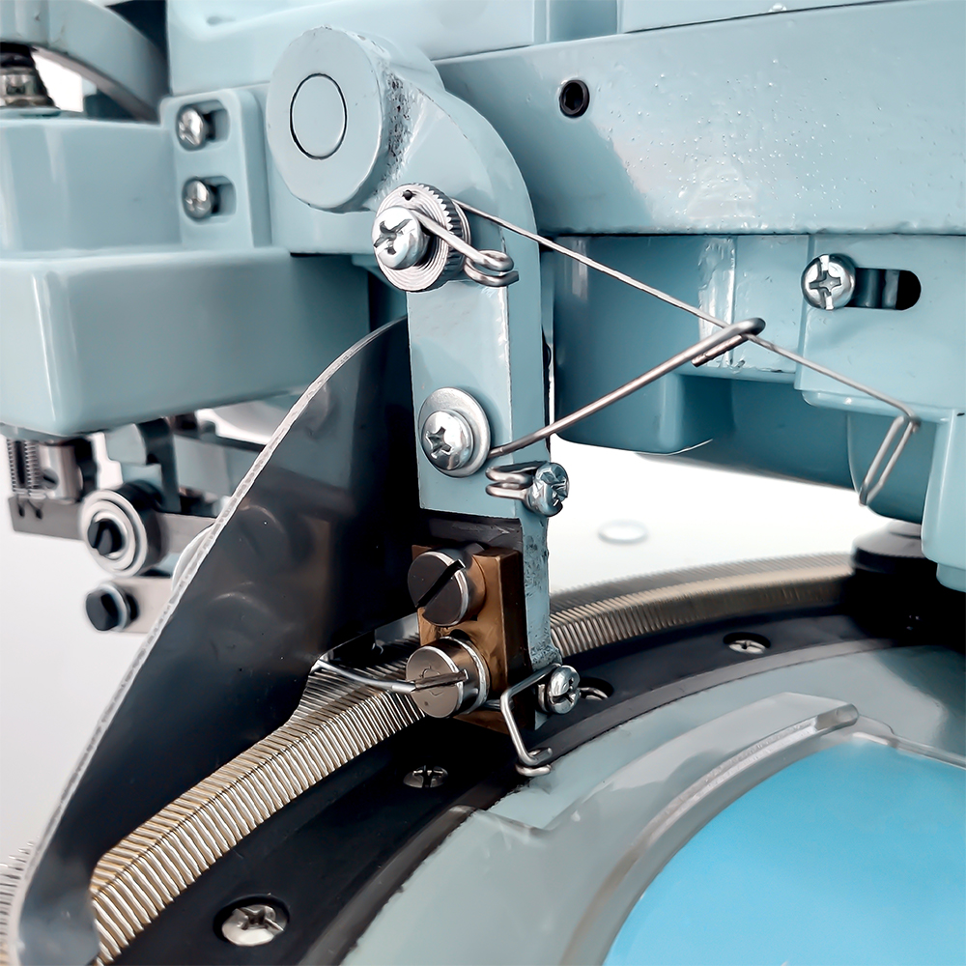
产品2：缝盘机-Dial Linking Machine
Needle type：3G—24G
Number of revolutions：450—480 revolutions
Disc diameter：14”
Weight：30KG
Packing size：630*500*250mm

Slide 7
产品3：缝纫机-Sewing Machine
Two-thread lockstitch，High/Low speed selector
Featuring 16 built-in basic stitch patterns·(1-4 linear stitch can be sewn with two needles)
Forward and reverse sewing/Automatic thread rewind
Sews sleeves/Adjustable stitch length/Drawer included
Use hand switch or foot pedal to start
Built-in sewing light/Includes thread cutter
Can sewing a button/Can sewing a button hole
Including all-purpose presser foot replacement holder
Uses DC 6V1.2A power
Foot pedal, adaptor, and thread bag included

Slide 8
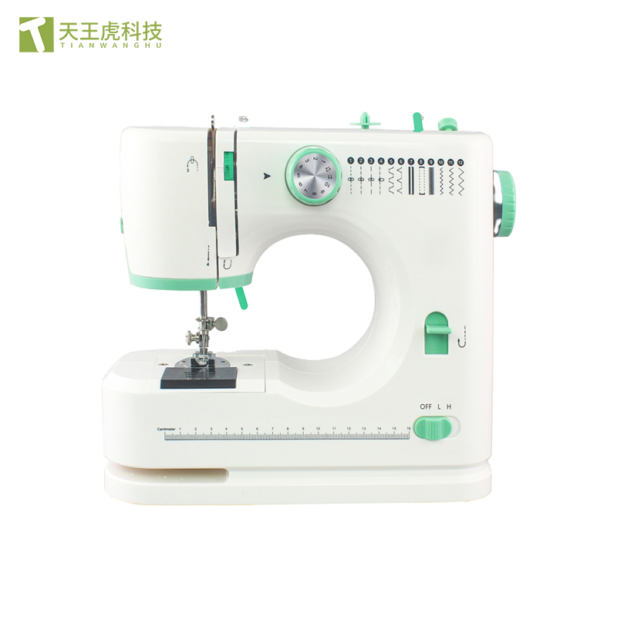
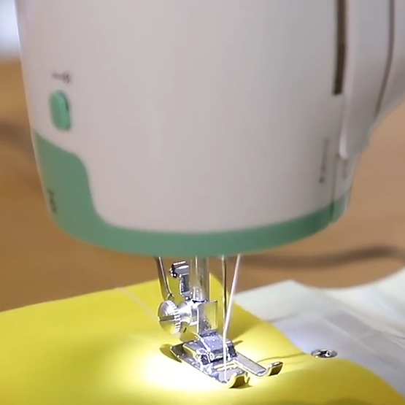
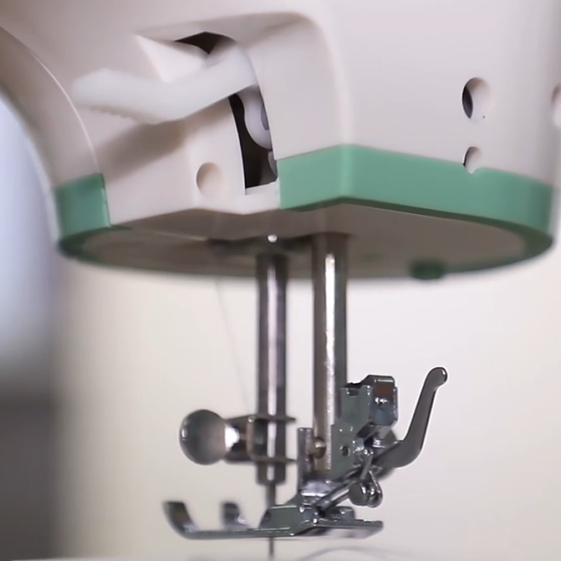
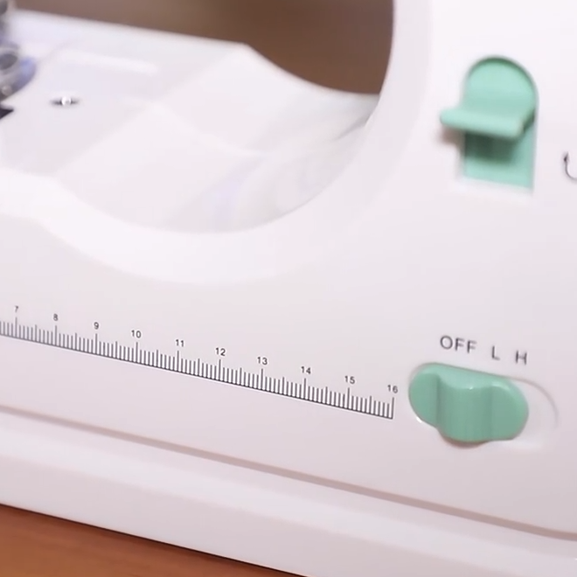
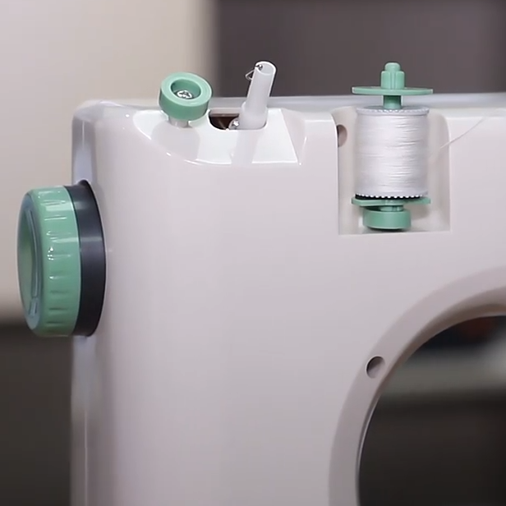
产品3：缝纫机-Sewing Machine
Product size：27.5×12.1×23.7 CM
Product weight：2067G
Color box size：32×15.5×29.3 CM
Qty：6 PCS
Carton box size：48×33.5×61 CM
N.W./G.W.：15.3/16.2 KGS
20’=1908，40’=3966，40’H=4446

Slide 9
产品4：门襟机-placket Machine
Multi-Functional and Efficient: This placket sewing machine is designed to meet the demands of various industries, including manufacturing plants, machinery repair shops, and retail. It can be easily integrated into existing production lines, ensuring a seamless workflow and minimizing downtime.
High-Quality Construction: With a sturdy flat-bed mechanical configuration and a powerful motor, this machine is built to withstand heavy usage and provide consistent performance. The CE and ISO 9001 certifications ensure that the machine meets international quality standards.
Advanced Features: The machine features automatic stop motions in case of yarn breakage or knotting, preventing damage to the fabric and reducing the risk of accidents. The semi-automatic system allows for easy operation and minimal labor requirements.

Slide 10
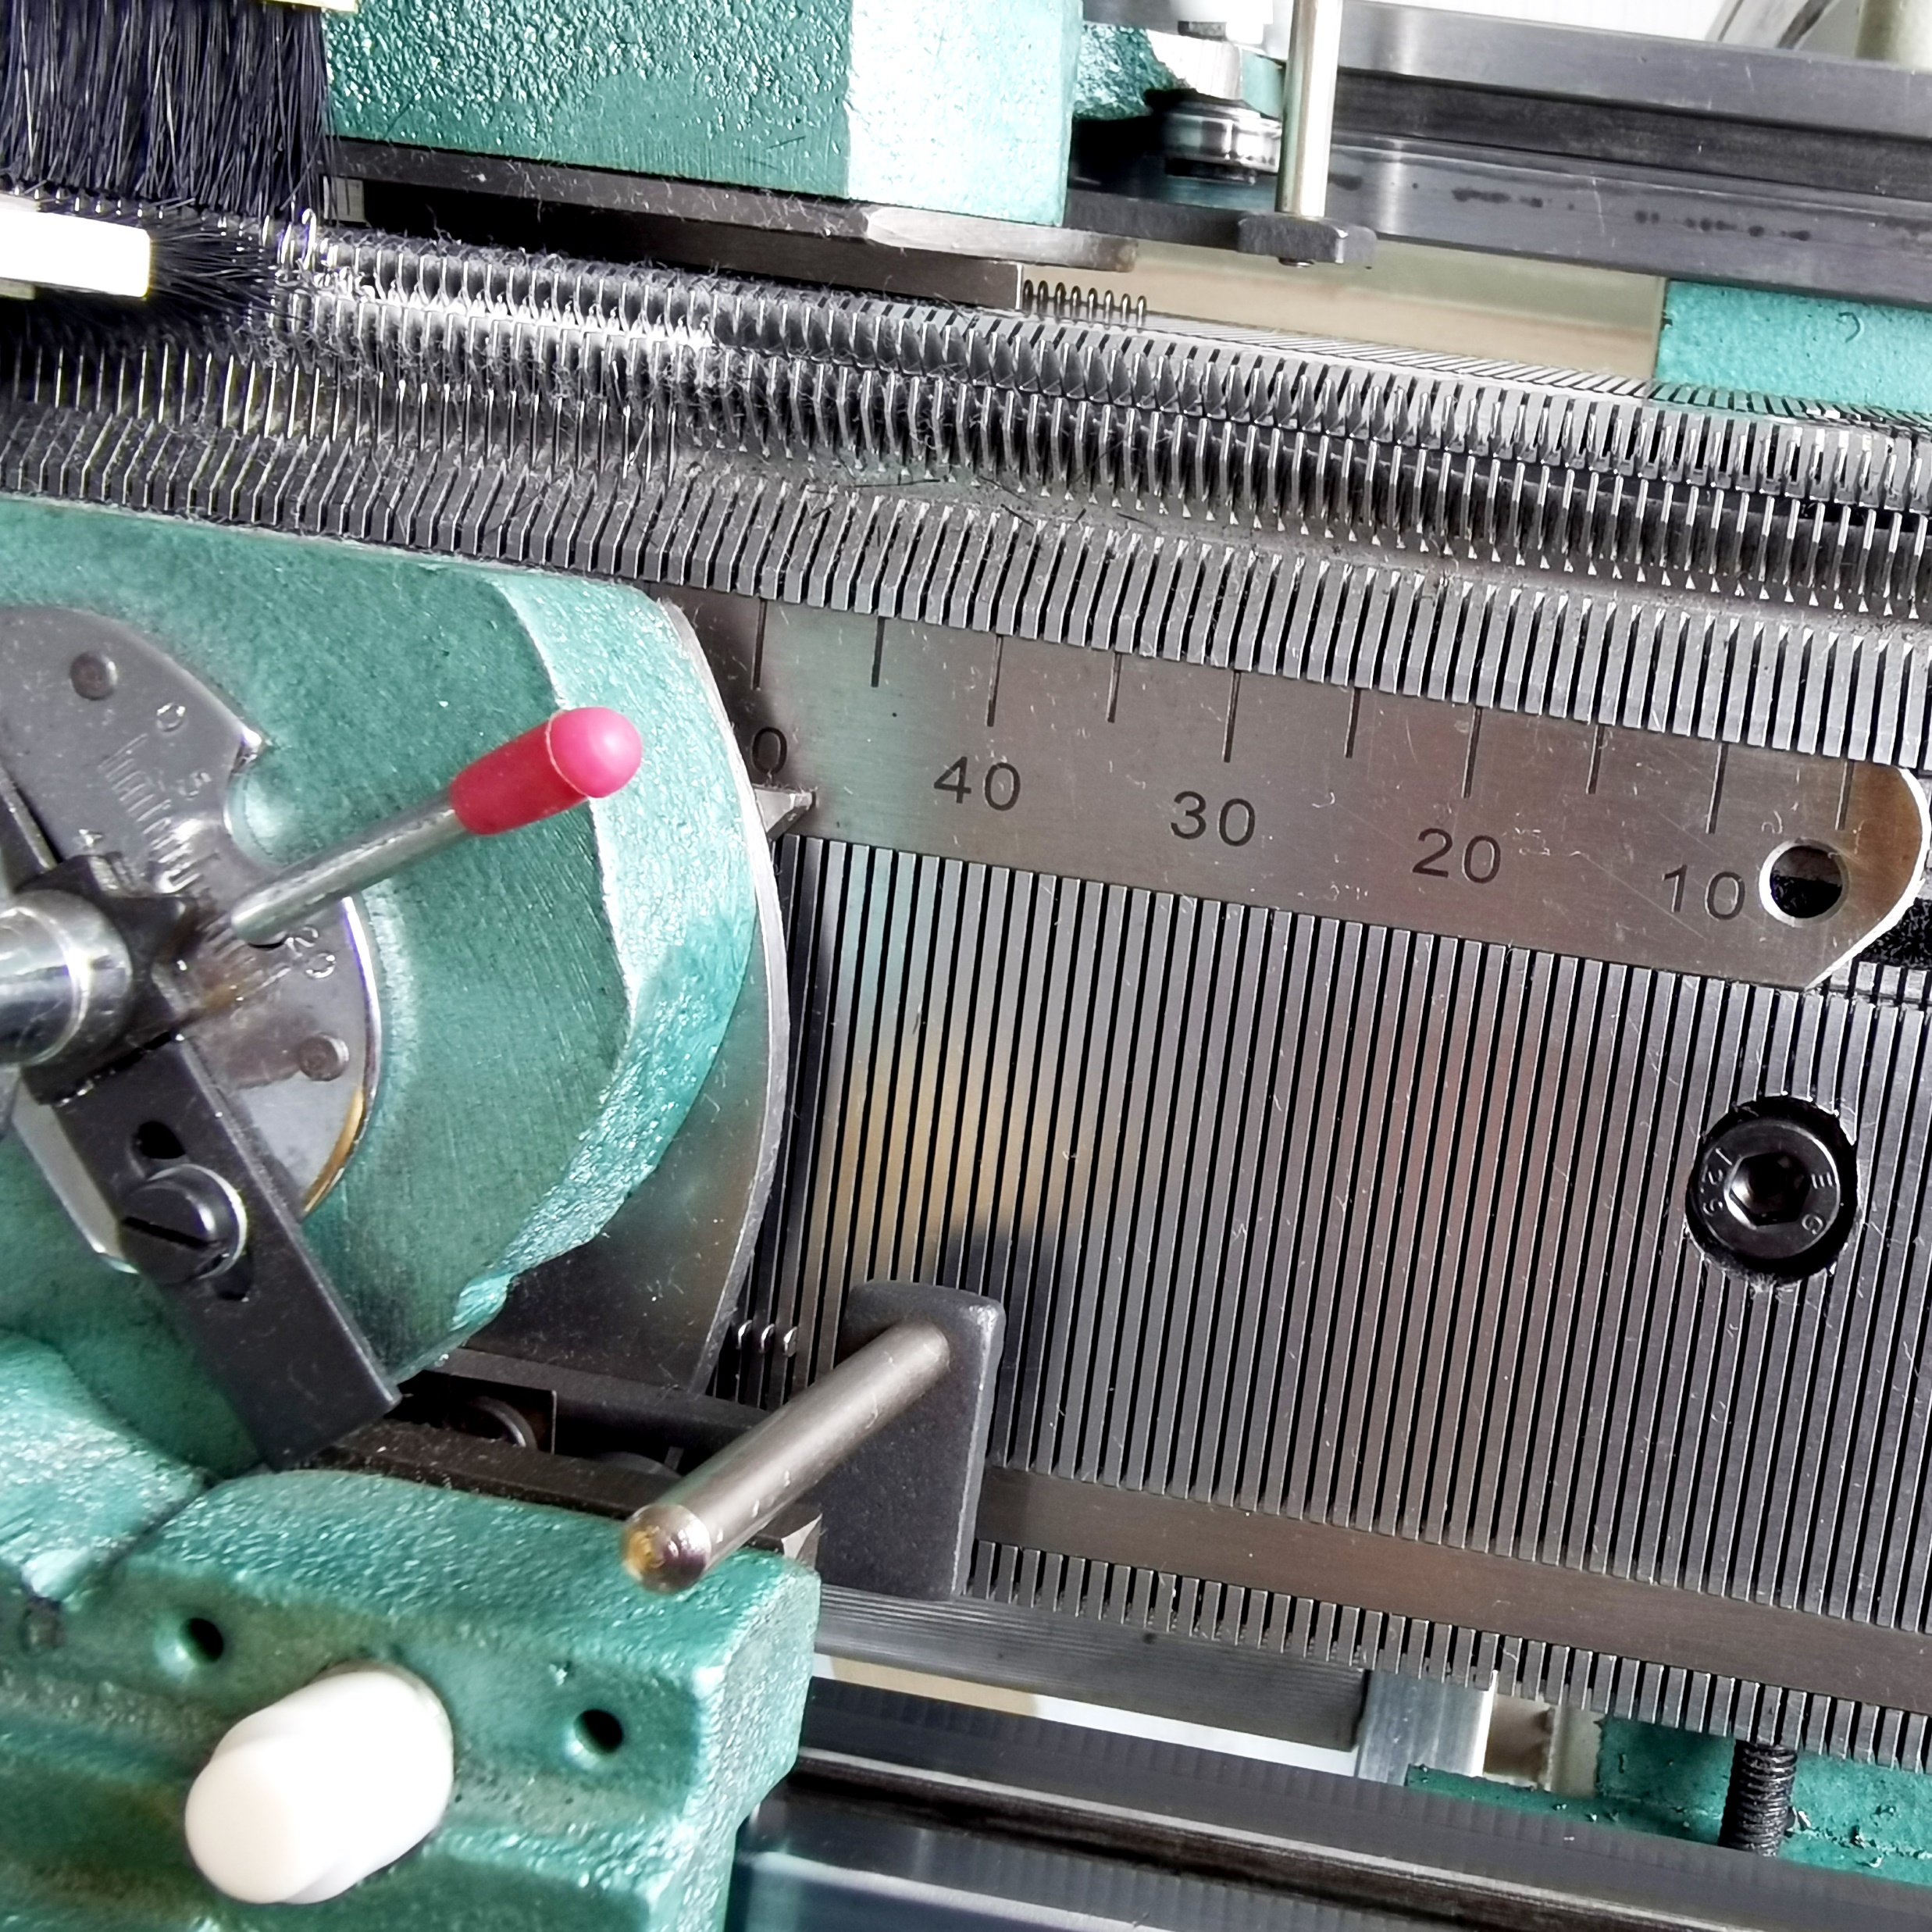
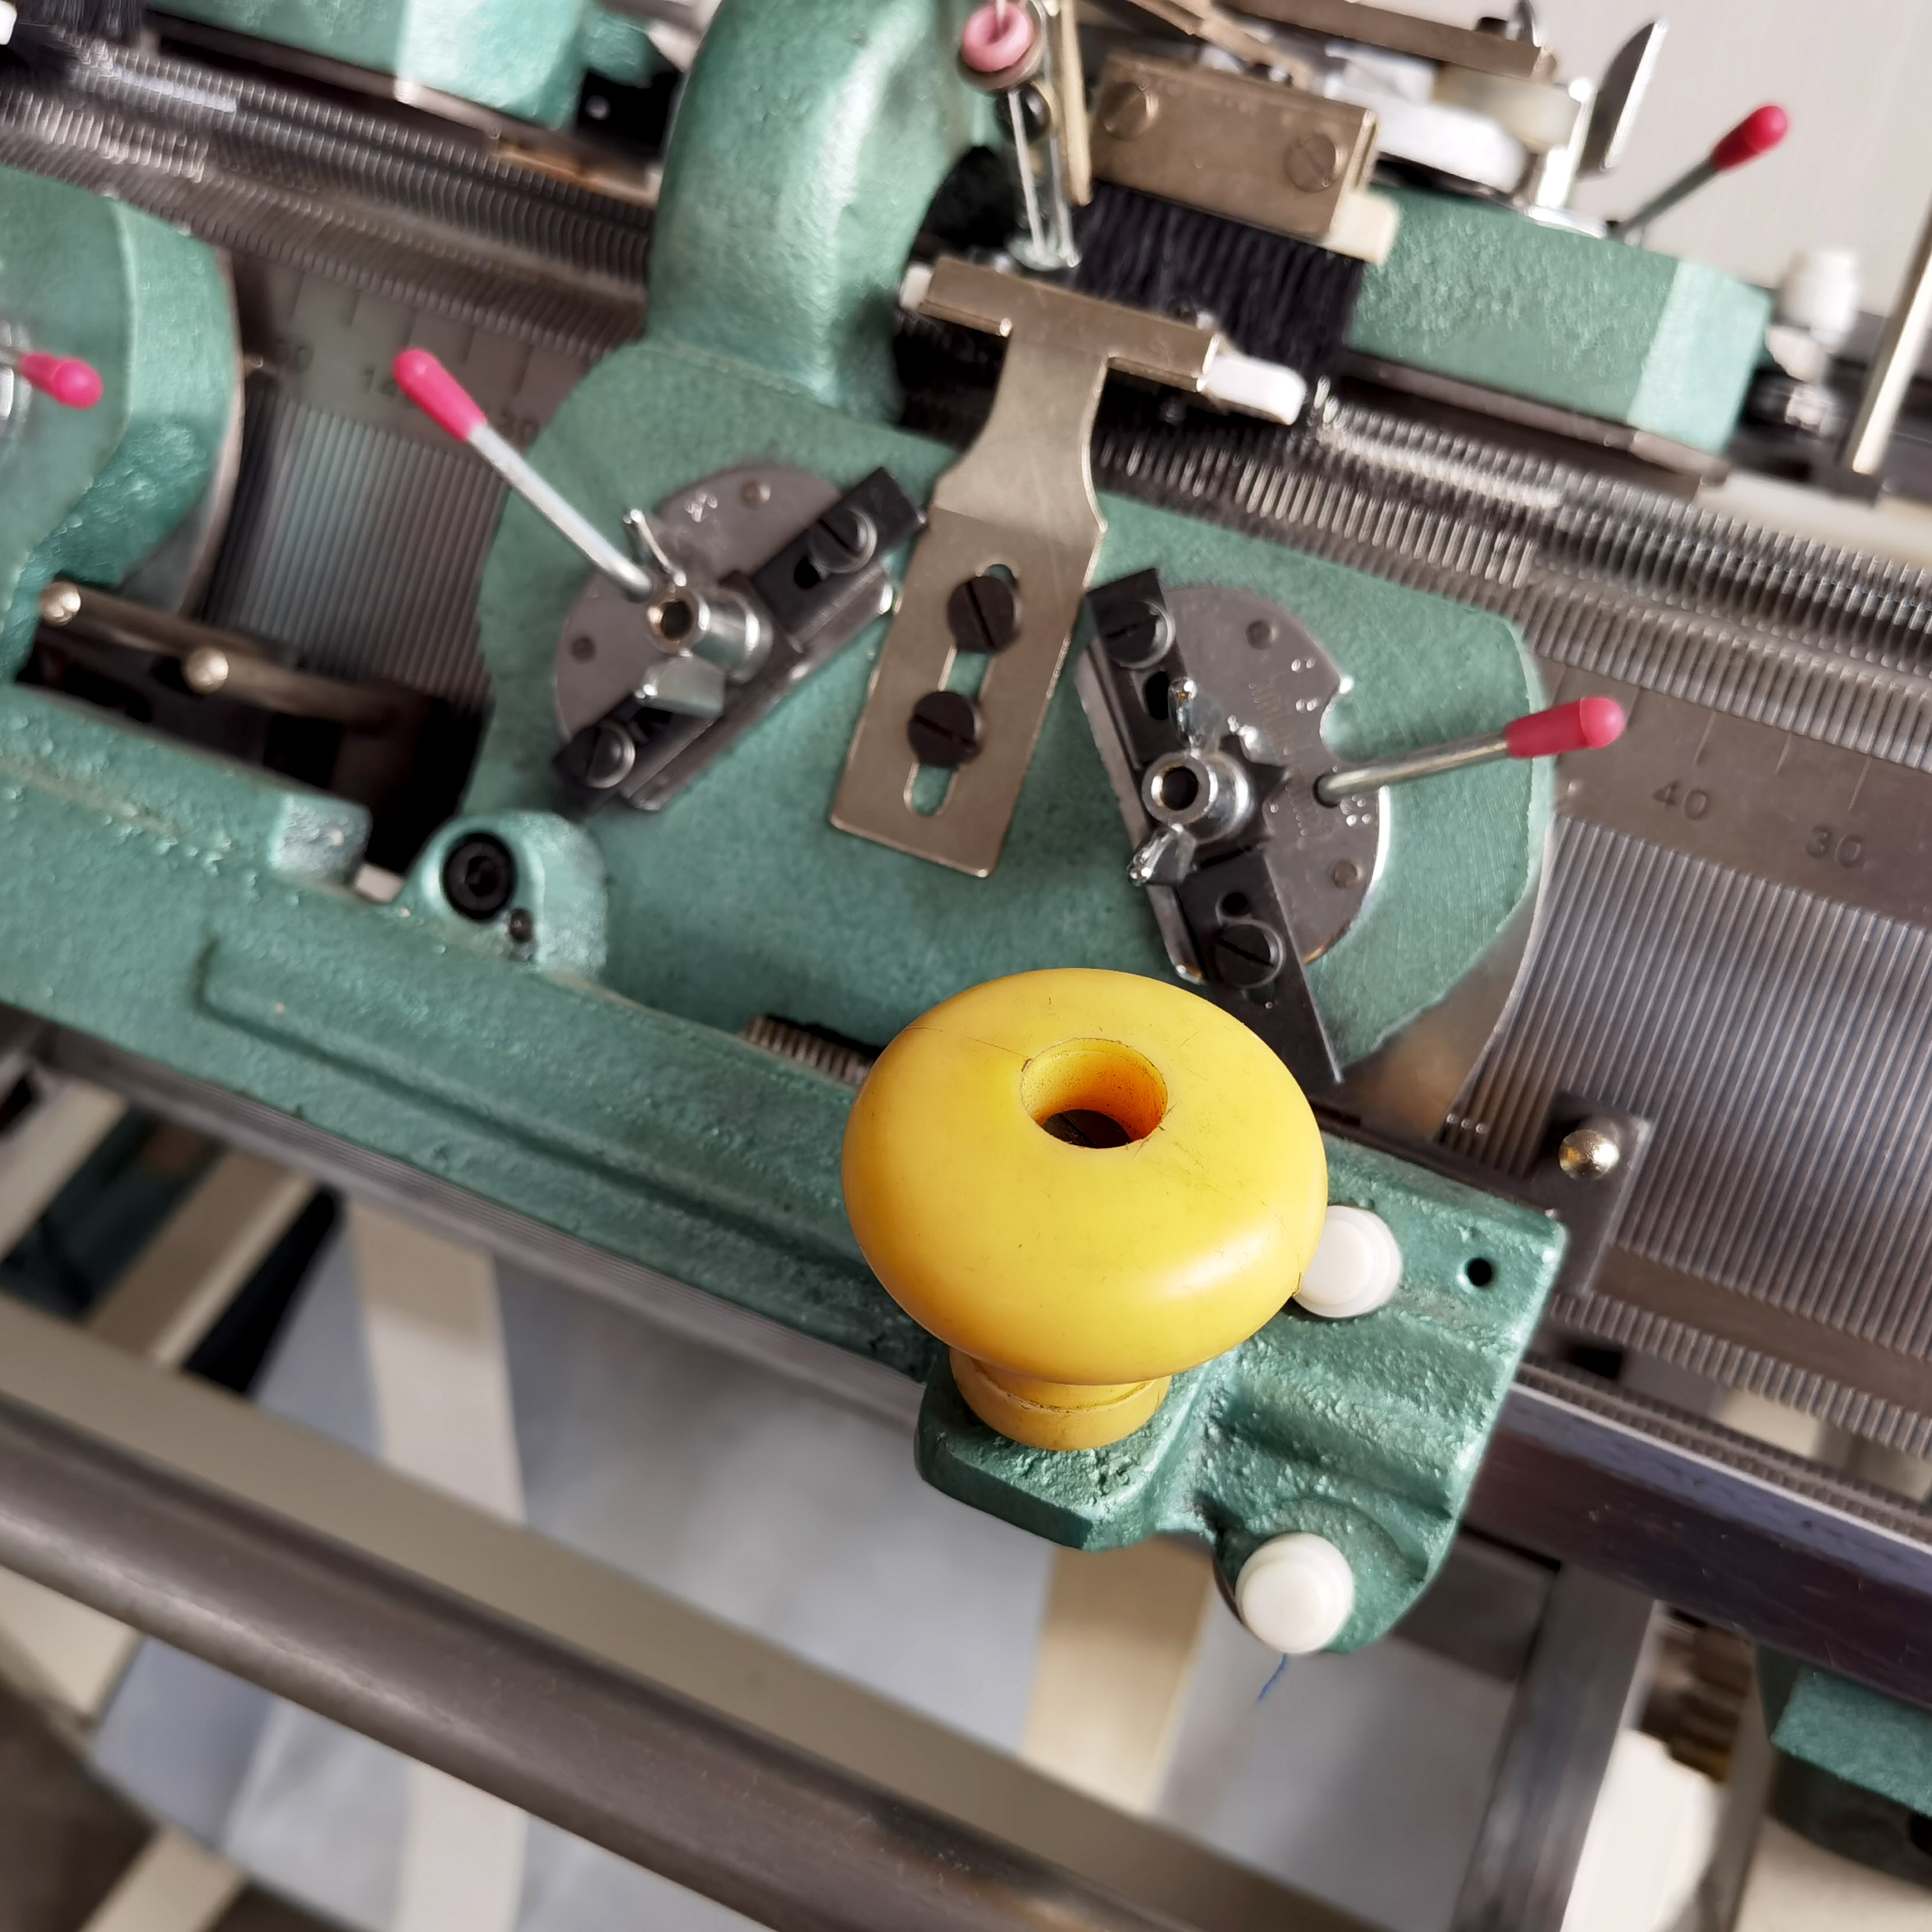
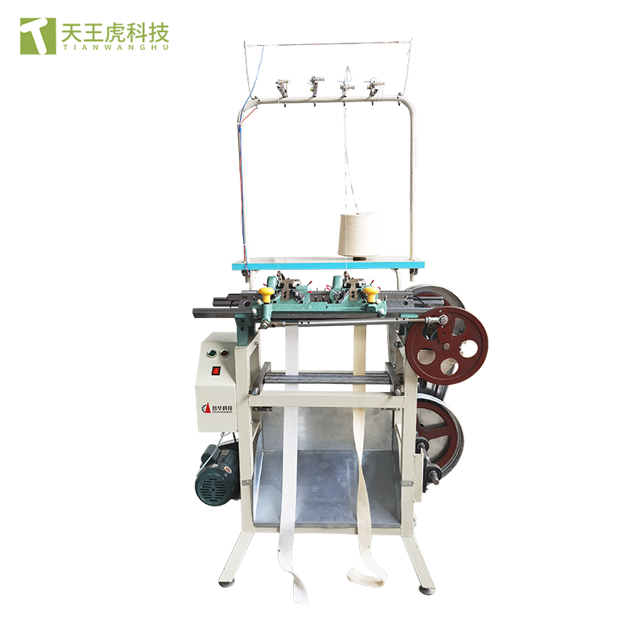
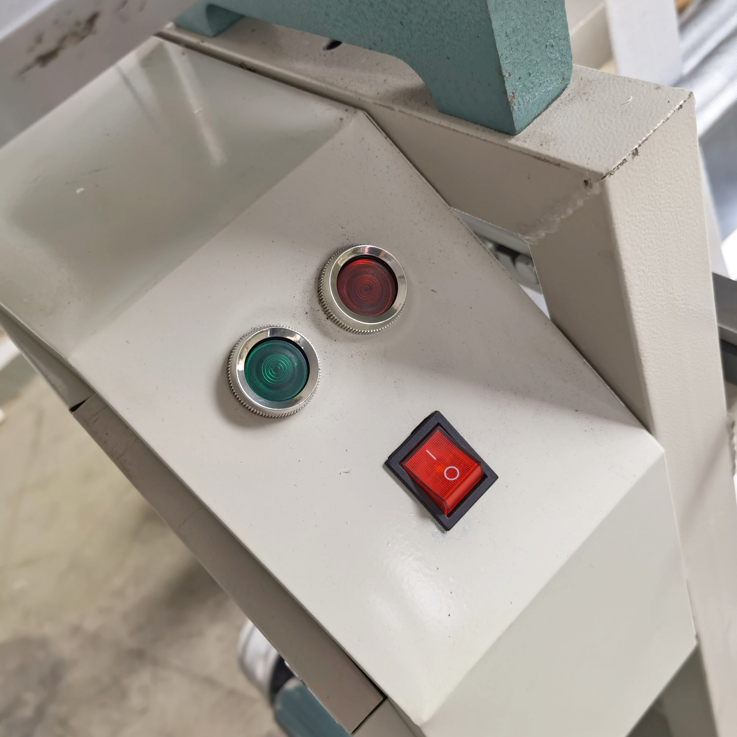
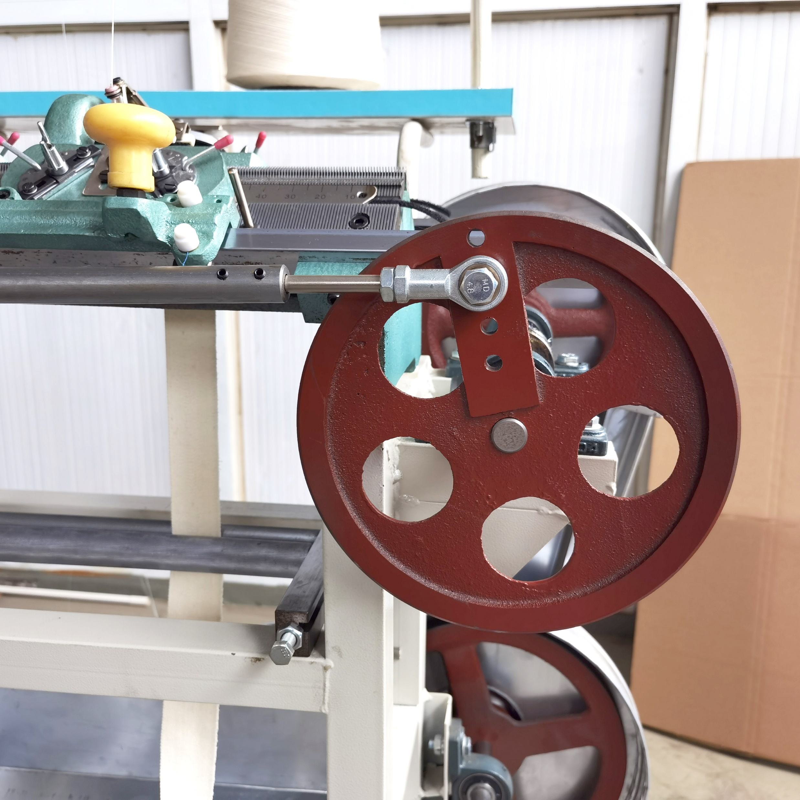
产品4：门襟机-placket Machine
Type：Industrial Sewing Machine
stitch length：3-18G
feed mechanism：Needle Feed
Applicable industries：Manufacturing Plant, Machinery Repair Shops, Retail
Condition: New
stitch formation: Plain
mechanical configuration: Flat-Bed
max. sewing thickness: Light
Key Selling Points: Multifunctional

Slide 11
产品5：拆片机： Sweater Yarn recycling machine
Apply for sweater factory open the rejected fabric, total 12 spindle in three level ,ensure 3-4 Pieces fabric D-Knitting meanwhile , also the yarn will be separated into yarn cone. In this way the yarn can be re-used , down factory running cost. Compact Layout of machine less space required.

Slide 12
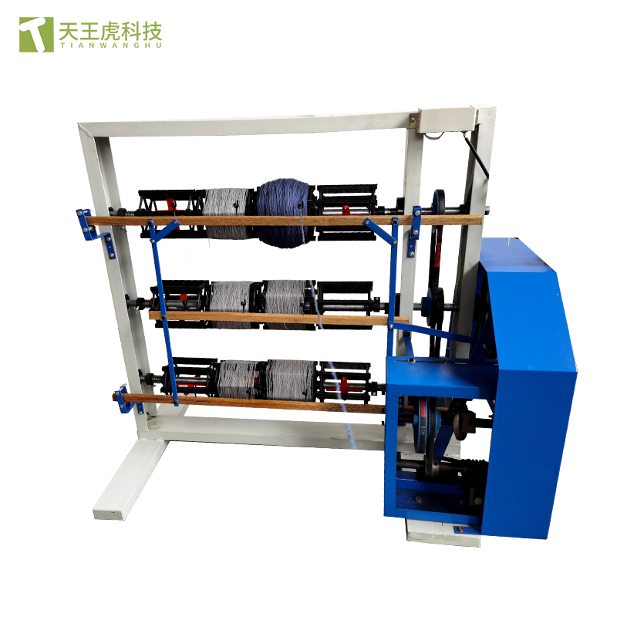
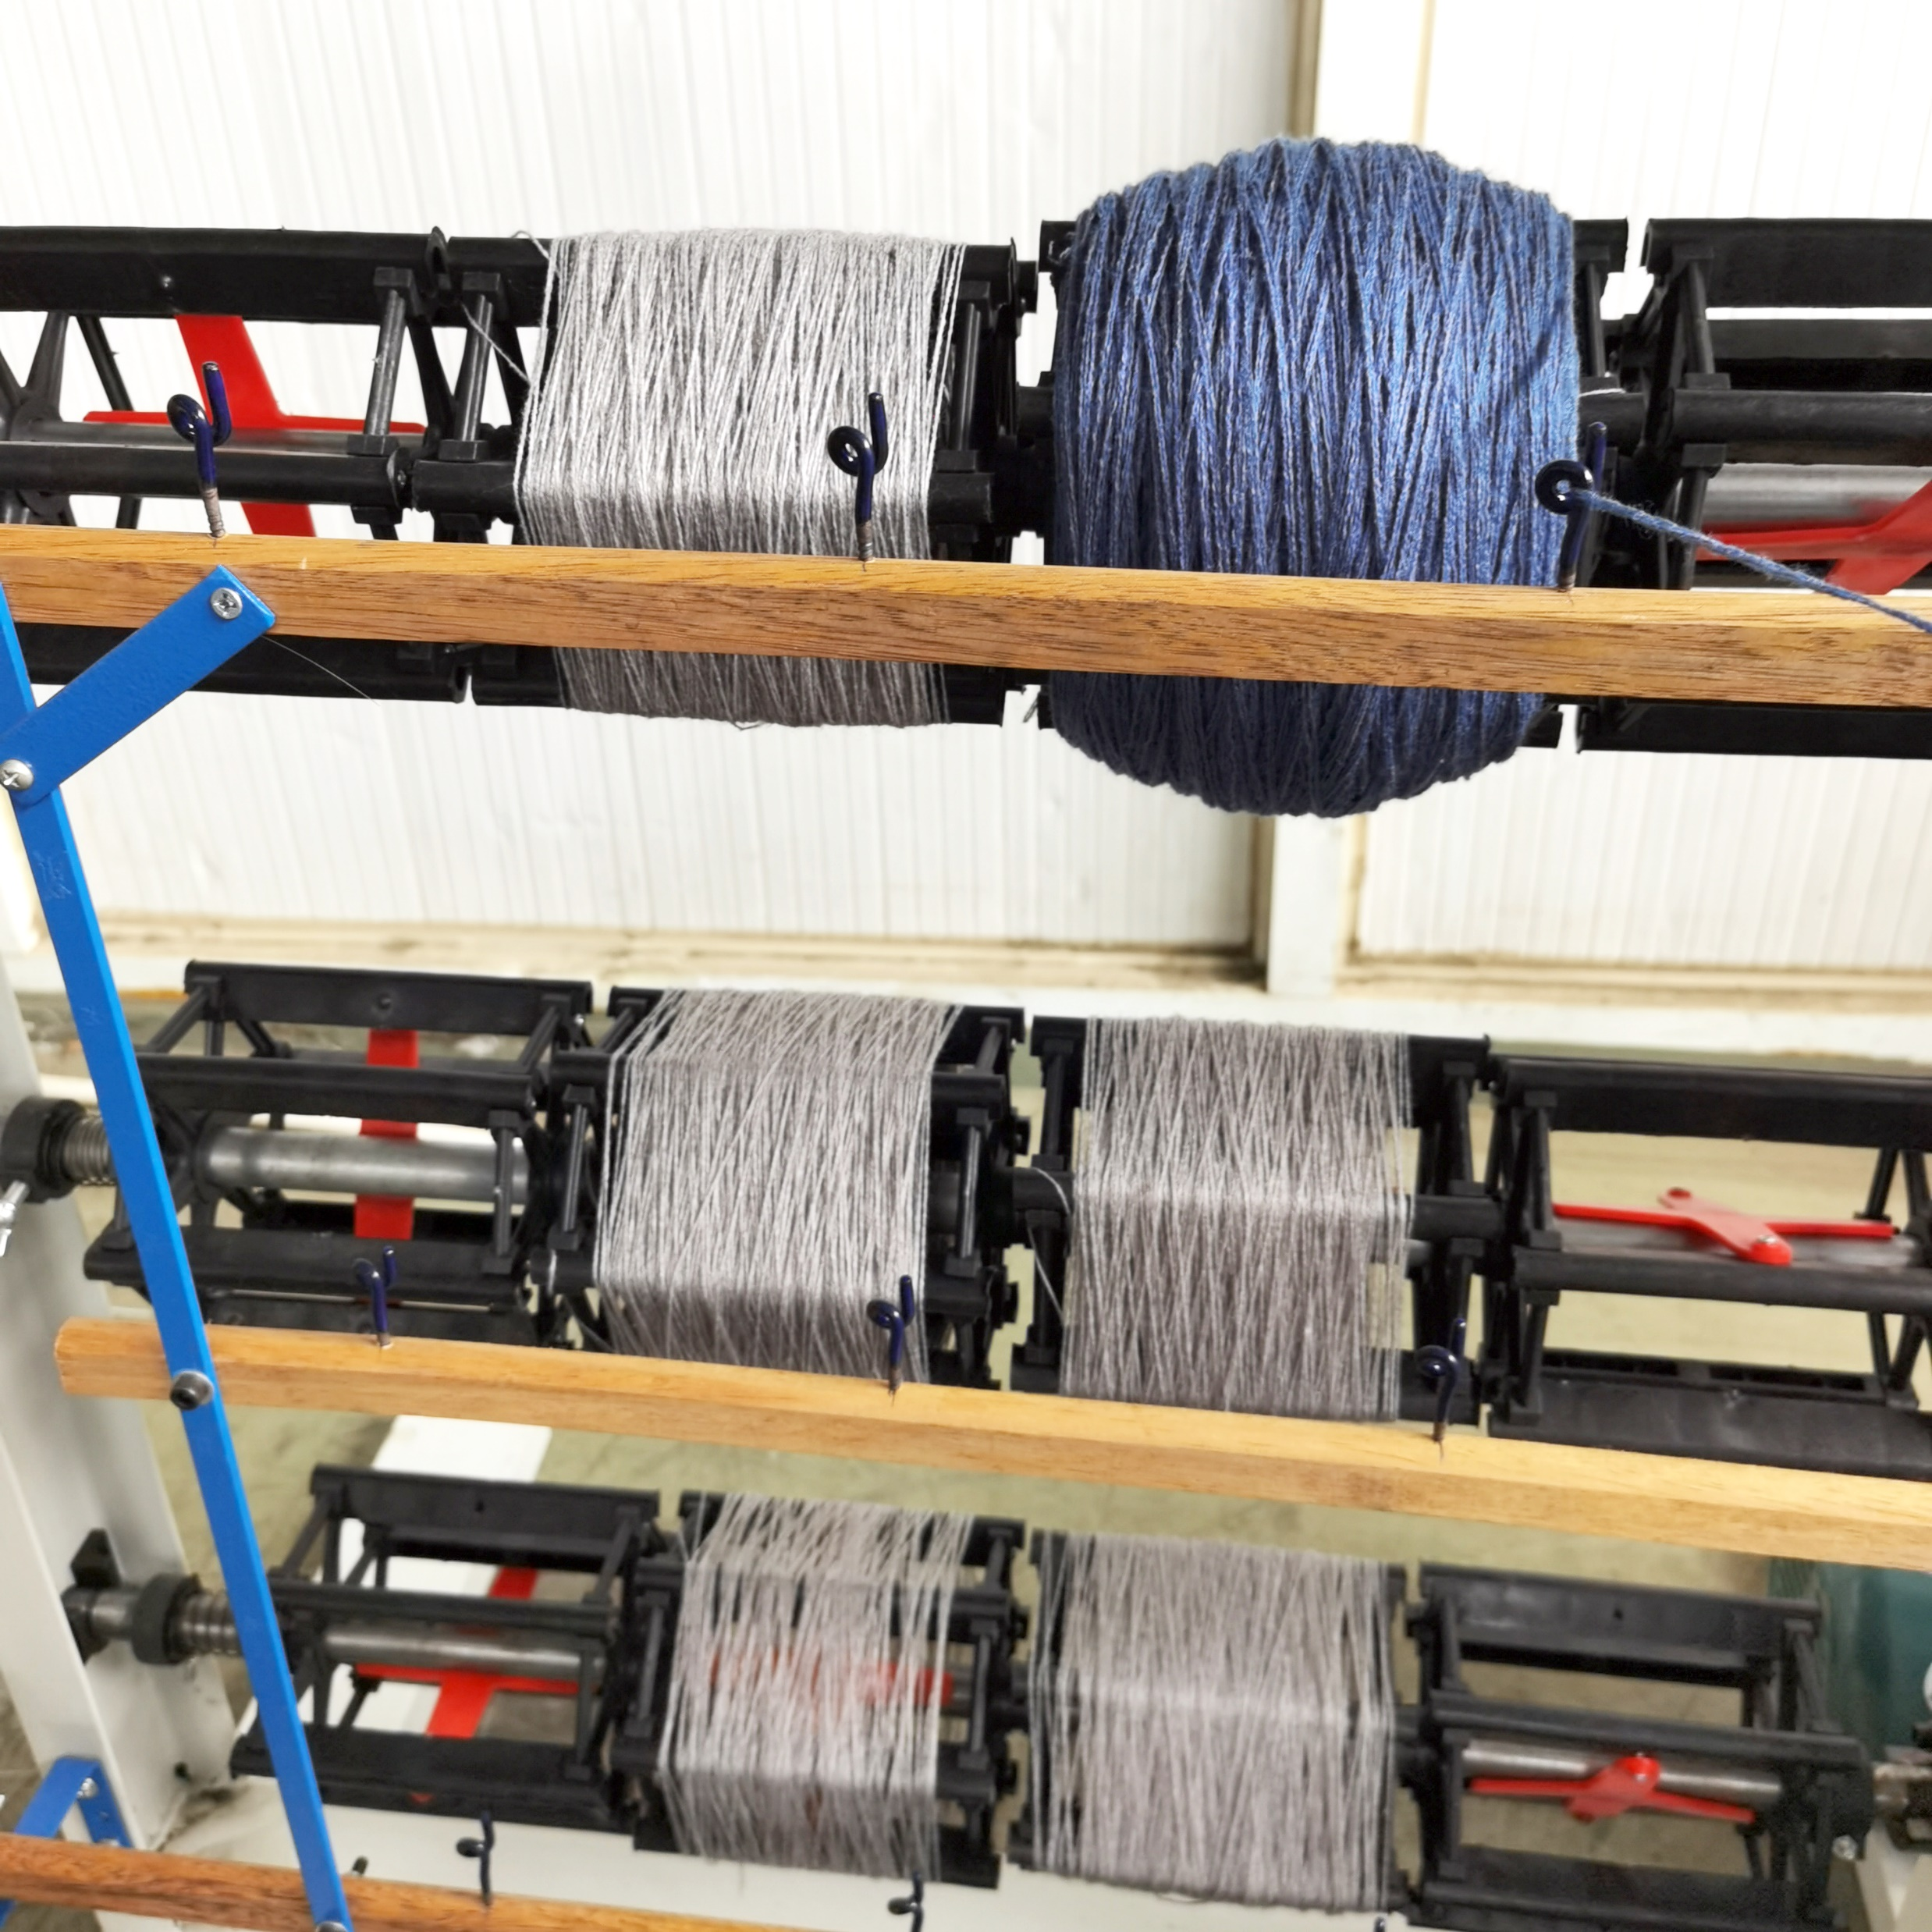
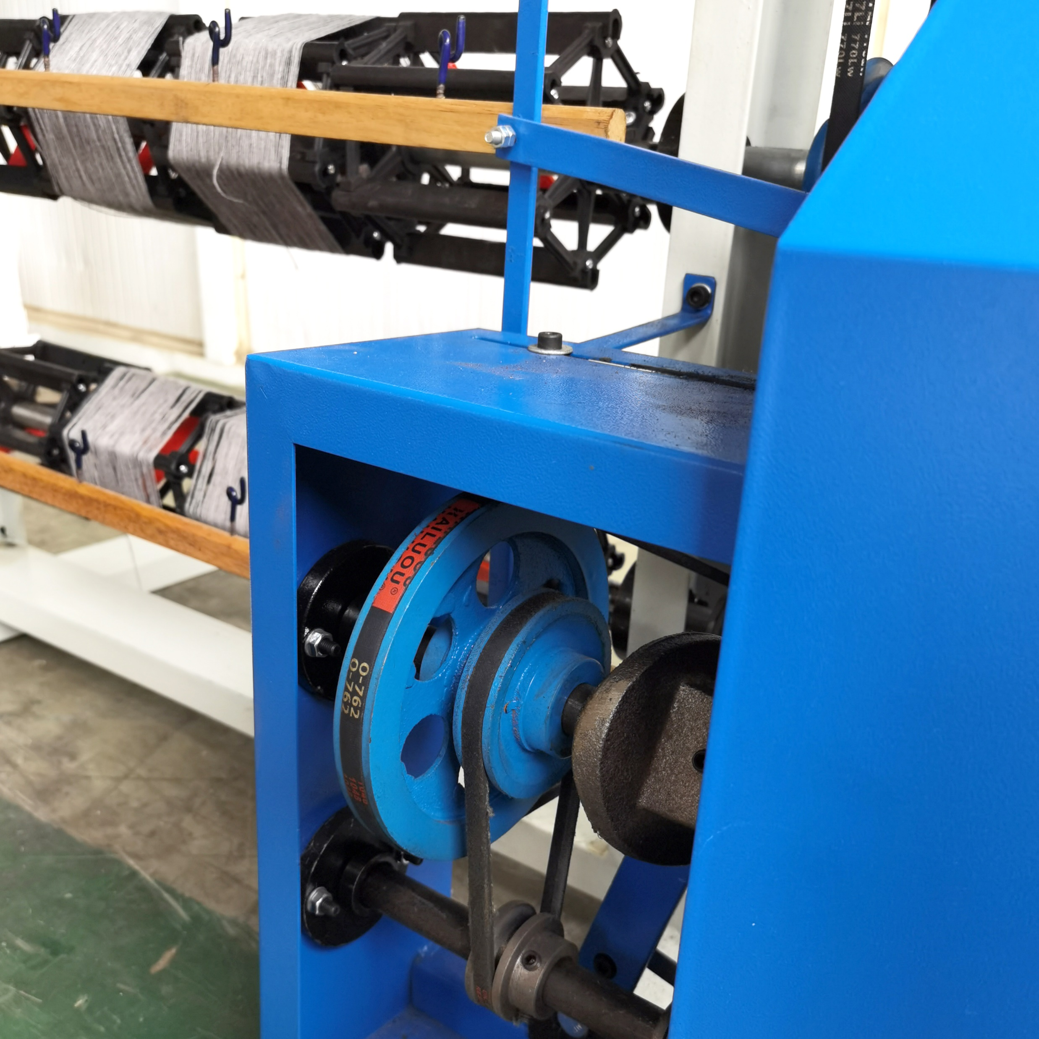
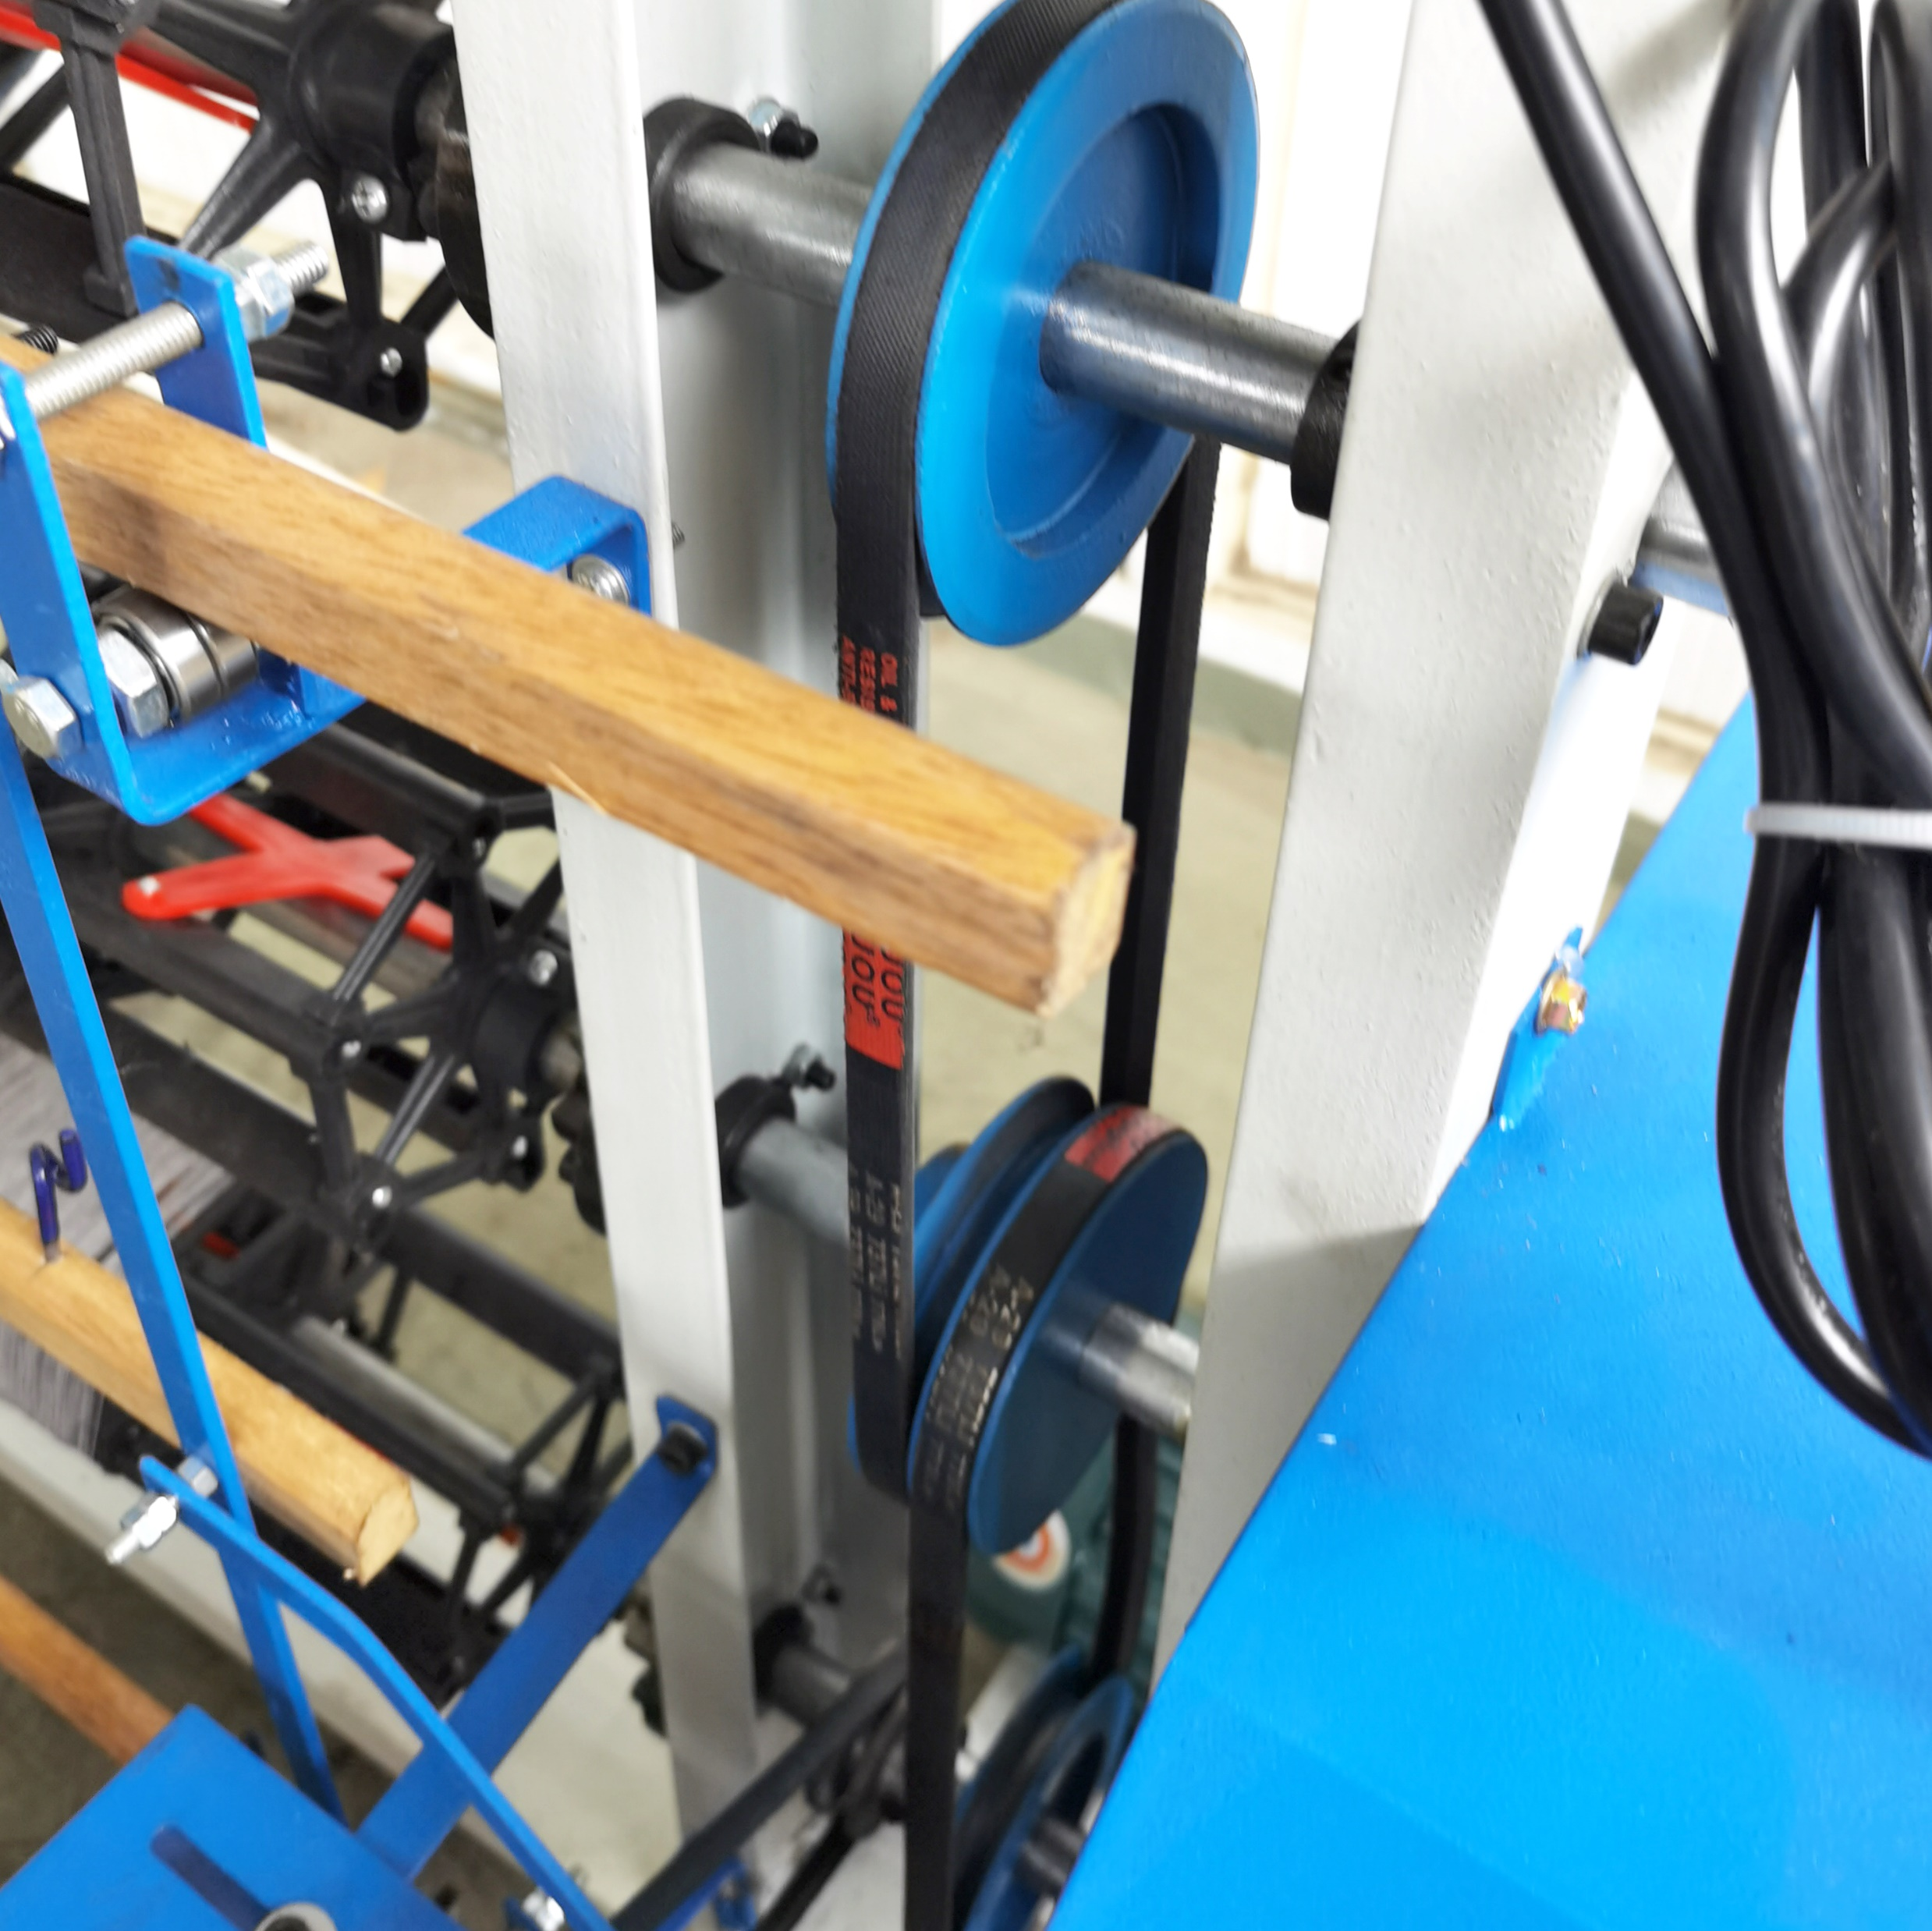
产品5：拆片机： Sweater Yarn recycling machine
With 12 spindle in three level,3*4
Stepping Motor driven ,input power single phase 220V,energy saving
Speed adjustable from the Inventor，apply for loose or tight knitting fabric
Stronger body less noise and easy operating

Slide 13
产品6：洗脱机：Industrial Washing & dehydrating Machine
Fully suspended automatic industrial washing and dehydrating machine. The inner tank and outer tank interface adopts docking method
High-quality oxidation-resisting steel panel and inner cylinder, longer service life and easier to clean.
304 stainless steel cylinder, durable and never rust.
The entire washing tank system is suspended on springs and shock absorbers, with a shock absorption rate of more than 95%, and no foundation is required when in use.
Equipped with an automatic detergent dispersing container, there will be no soap powder accumulation
It uses full computer control, variable frequency speed regulation, washing program human-machine dialogue, and the LCD screen displays clearly. It has a fault and function self-checking system to make maintenance easier.

Slide 14
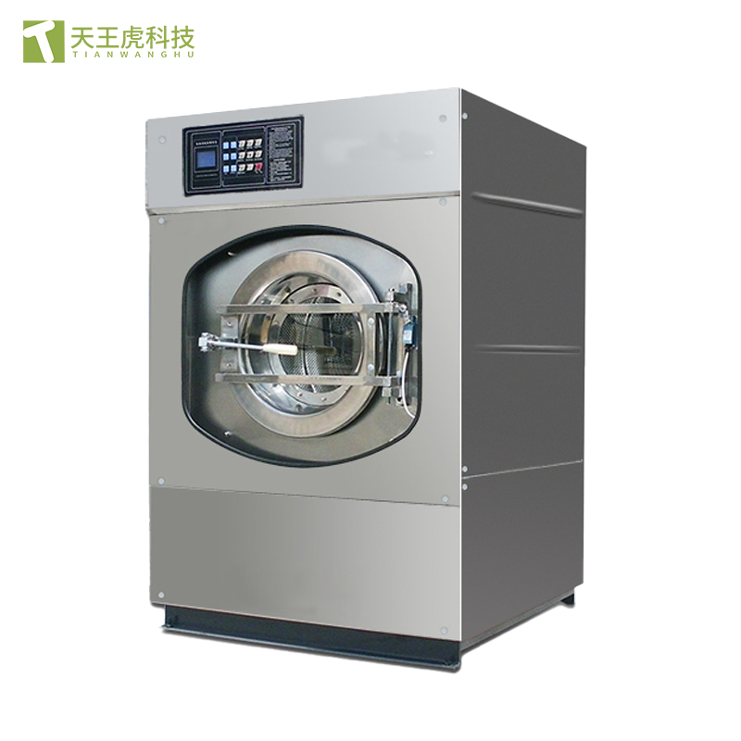
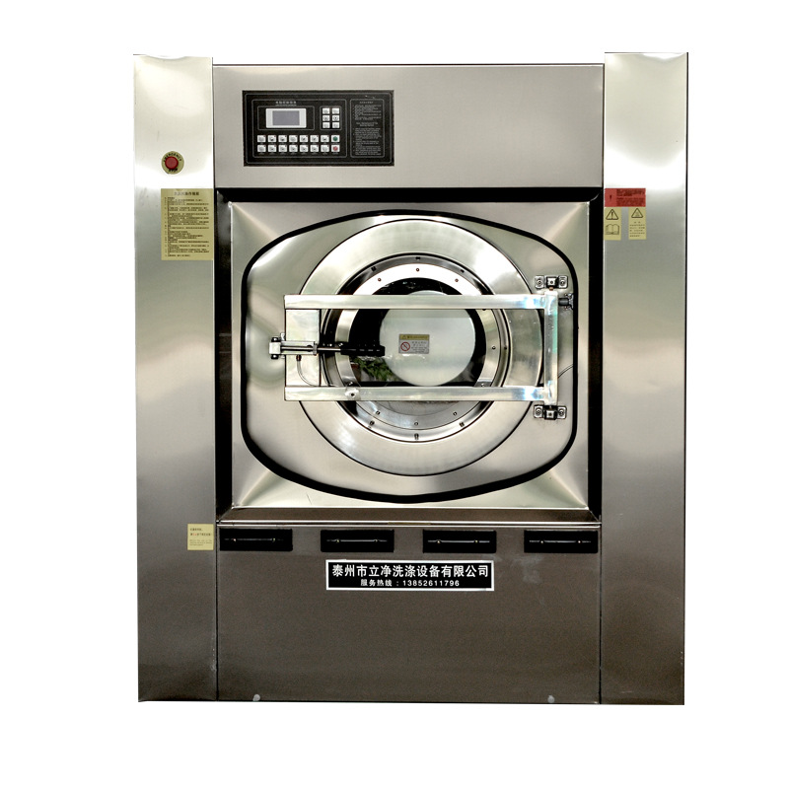
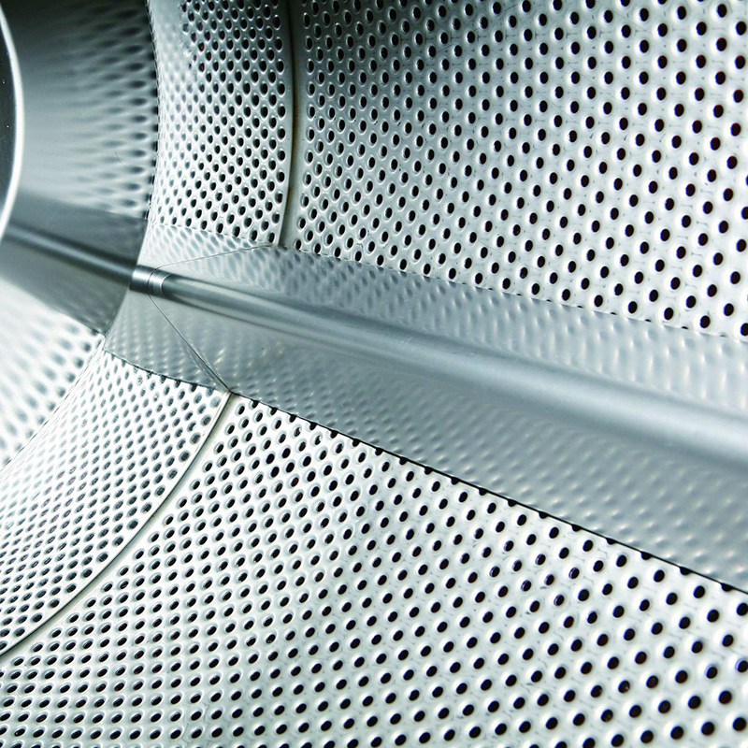
产品6：洗脱机： Industrial Washing & dehydrating Machine
Model: XGQ-30
Capacity: 30KG
Drum: φ900*500mm
Washing speed: 36r/min
Uniform speed; 75r/min
Medium dehydration speed: 400r/min
High dehydration speed: 800r/min
Drain valve: φ60mm
Cold water pipe: 3/2”
Water consumption: 720KG
Motor power: 3KW
Electric heating power: 24KW
Dimensions: 1550*1550*1760mm

Slide 15
产品7：纱线-Yarn Material
‌Knitting yarn‌ is yarn used for hand-knitted fabrics or the production of knitted goods. According to the raw materials, knitting yarn can be divided into cotton knitting yarn, wool knitting yarn and blended yarn. According to the spinning system, knitting yarn can be divided into carded knitting yarn and combed knitting yarn. Knitting yarn usually uses better raw materials, the yarn is smooth, the twist is small, and the hand feels soft.
Knitting yarn has high strength and good elasticity, and is suitable for various knitted products such as sweaters, socks, underwear, etc. Due to its high finish, low twist and soft feel, knitting yarn is widely used in clothing manufacturing.

Slide 16
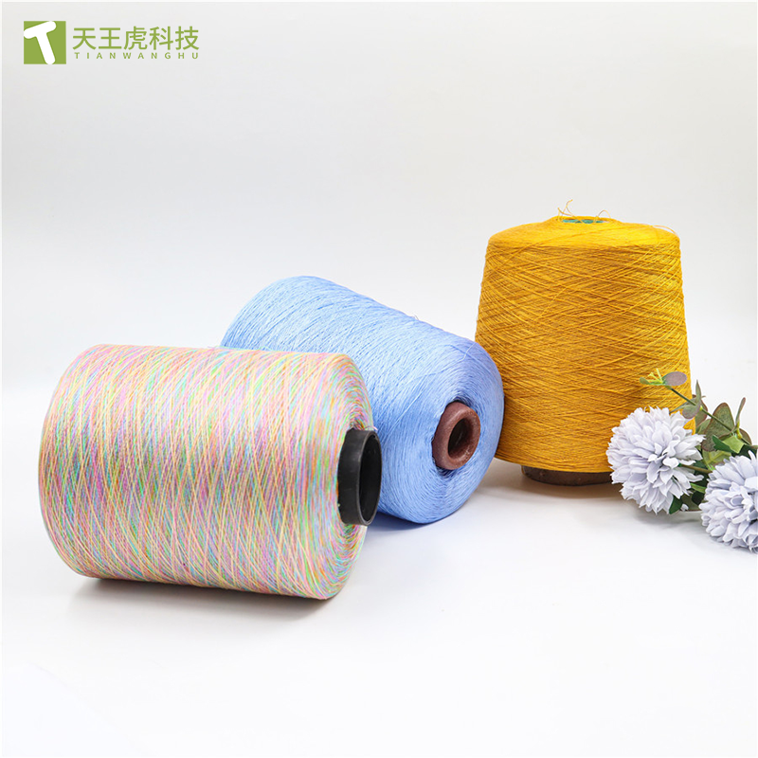
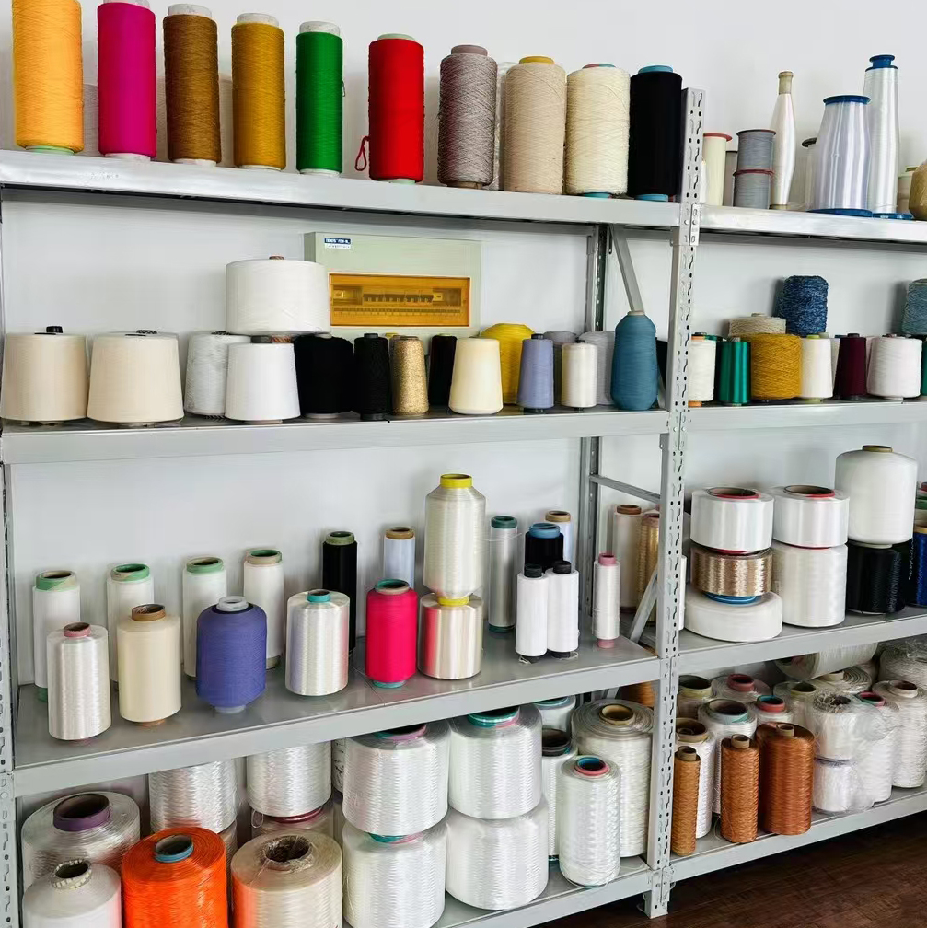
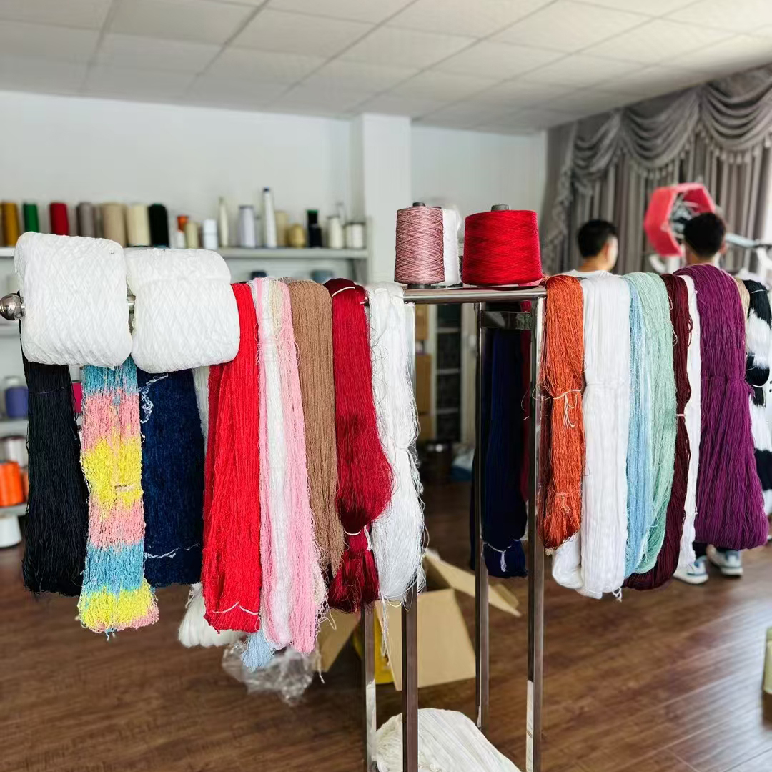
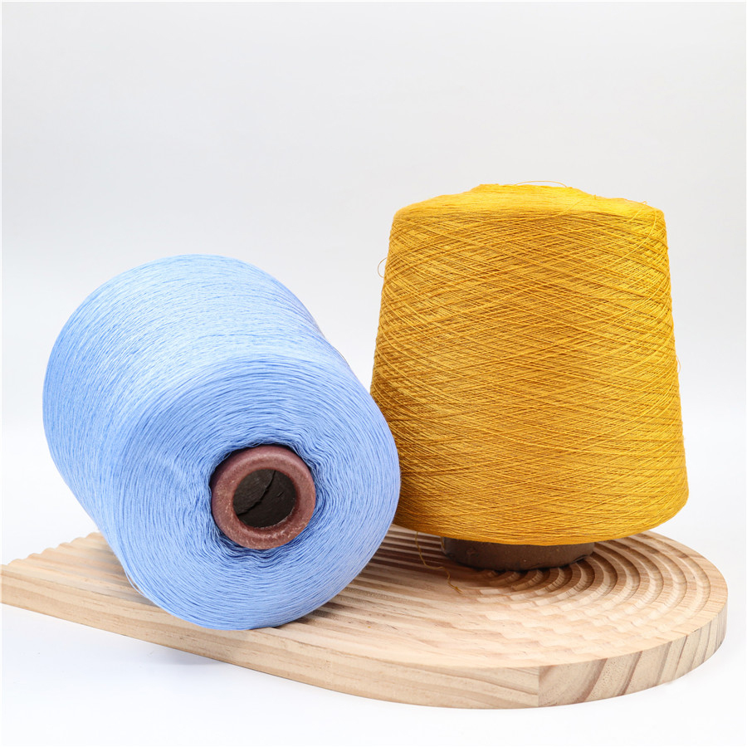
产品7：纱线-Yarn Material
‌Classification by raw materials‌:
1. Cotton knitting yarn‌: Made from cotton fibers.
2. Wool knitting yarn‌: Made from wool or cashmere.
3. Blended yarn‌: Made from a mixture of cotton, wool or other fibers.
‌Classification by spinning system‌:
1. ‌Combed knitting yarn‌: Made from a combing process, suitable for the production of rugged knitwear.
2. Combed knitting yarn‌: Made from a combing process, suitable for the production of high-end, fine knitwear.

Slide 17
产品9：烘干机-Industrial Drying Machine
The working principle of the dryer is mainly to achieve the evaporation of water through heat conduction, convection and radiation heat transfer. For example, the hot air drum dryer uses the hot air flow to move forward from the tail to fully contact the material, and fully utilizes the heat conduction, convection and radiation heat transfer to continuously evaporate the moisture of the material in the drum. The inner spiral stirring, sweeping and lifting plates promote the movement of the material to complete the entire drying process.
The performance characteristics of the dryer include high efficiency, safety and convenience. They can remove a large amount of moisture from the material in a short time, are easy to operate, and have fire safety protection devices. In addition, the drum dryer also has a variety of drying modes and temperature controls, and users can choose different modes and temperatures according to their needs.

Slide 18
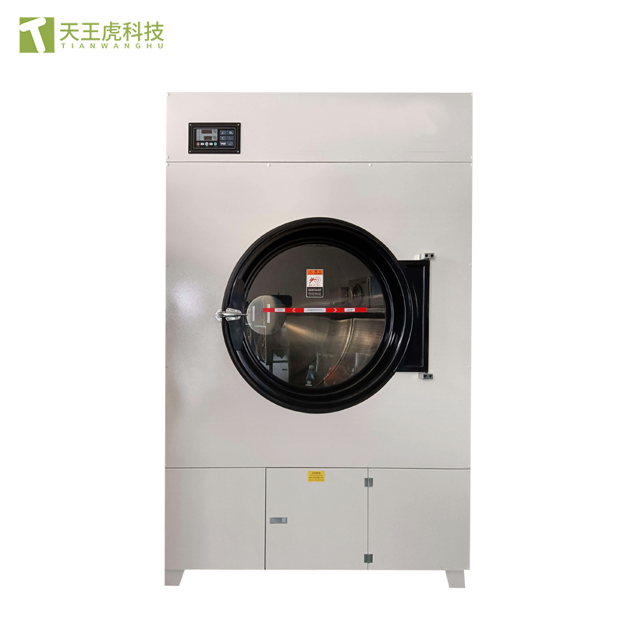
产品9：烘干机-Industrial Drying Machine
Model: HGJ-50
Capacity: 50KG
Drum size: φ1170*800mm
Drum speed: 35r/min
Total motor power: 3KW
Electric heating power: 21KW
External dimensions: 1280*1450*2100mm
Inner drum material: stainless steel

Slide 19
产品10：烫台-Industrial Ironing Table
Industrial ironing tables are essential equipment in garment making, the textile industry, and other fields that require ironing materials. They are mainly used to smooth, shape, and remove wrinkles from various types of fabrics, leather, synthetic fibers, and other materials, ensuring that the finished product has a neat and professional appearance.
‌Tabletop‌: Usually made of high-temperature resistant and uniformly heat-conductive materials, such as stainless steel or special alloys, to ensure uniform heat distribution during ironing and avoid local overheating.
‌Heating system‌: Built-in electric heating elements (such as heating wires, heating plates) or steam heating devices provide a stable heat source. Some high-end ironing tables are also equipped with temperature control systems that can accurately adjust and maintain the required working temperature.
‌Ironing pad/blanket‌: Placed on the tabletop, in direct contact with the material, it protects the material from direct high temperature damage and enhances the ironing effect.
‌Pressure adjustment device‌: Some ironing tables are equipped with an adjustable pressure function to adapt to the ironing needs of different materials and thicknesses by changing the pressure of the ironing head or tabletop.
‌Safety device‌: Includes overheating protection, automatic power off and other functions to ensure safe operation.

Slide 20
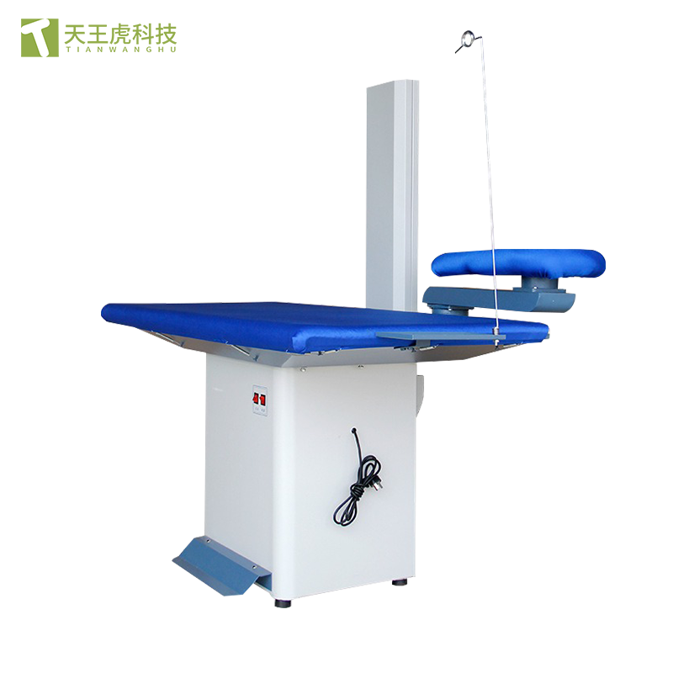
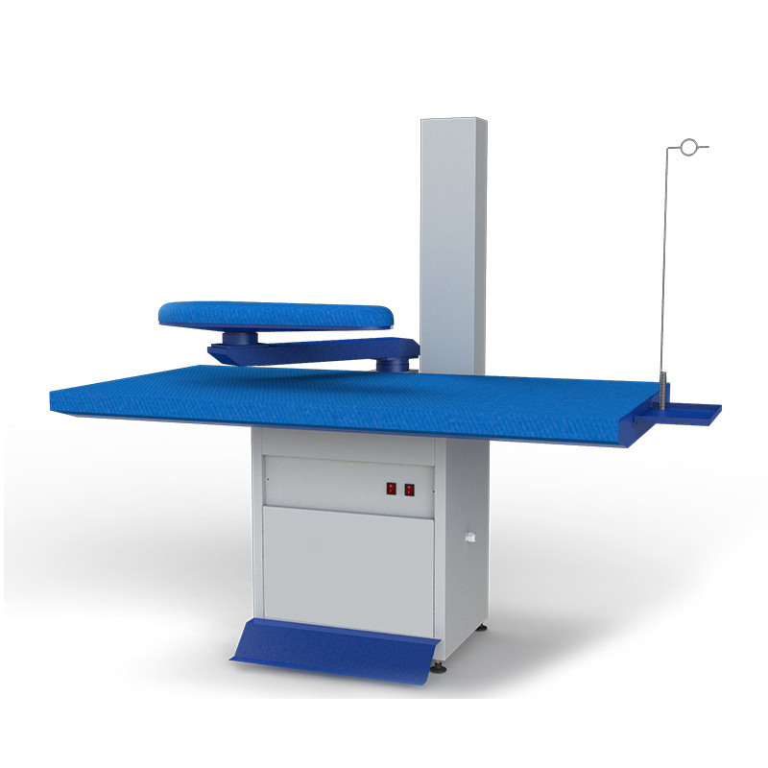
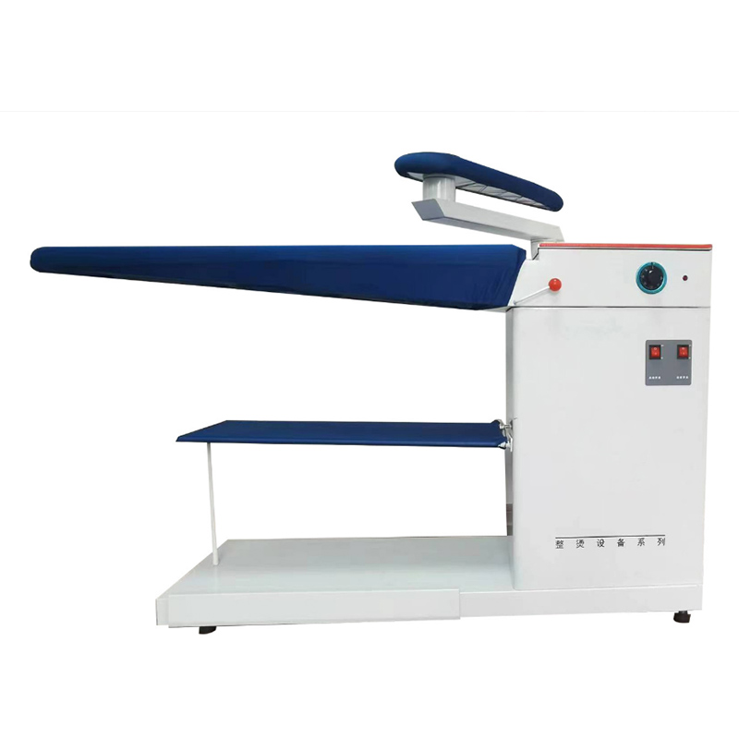
产品10：烫台-Industrial Ironing Table
Model: YTT-1575
Table size: 750x1500
Power supply voltage: 220V/380V
Motor power: 550 4p/800 2p
Rated input power: 1.3kw
Length x width: 1500x750
Net weight: 88kg

Slide 21
产品11：罩衫灯-Sweater Inspection Lamp
This light is specially designed for the final inspection of elastic clothing such as wool/knitted products. The lower part of the light body is a full PVC 360-degree turntable. The circuit and turntable structure are specially designed to allow it to rotate 360 ​​degrees without leakage, short circuit or uneven rotation.
2. Long life and less maintenance. The inspection part of the light body adopts 3.2 imported milky white acrylic plate to form the light piece, and 2 sets of open light tubes are installed inside, which are easy to replace.

Slide 22
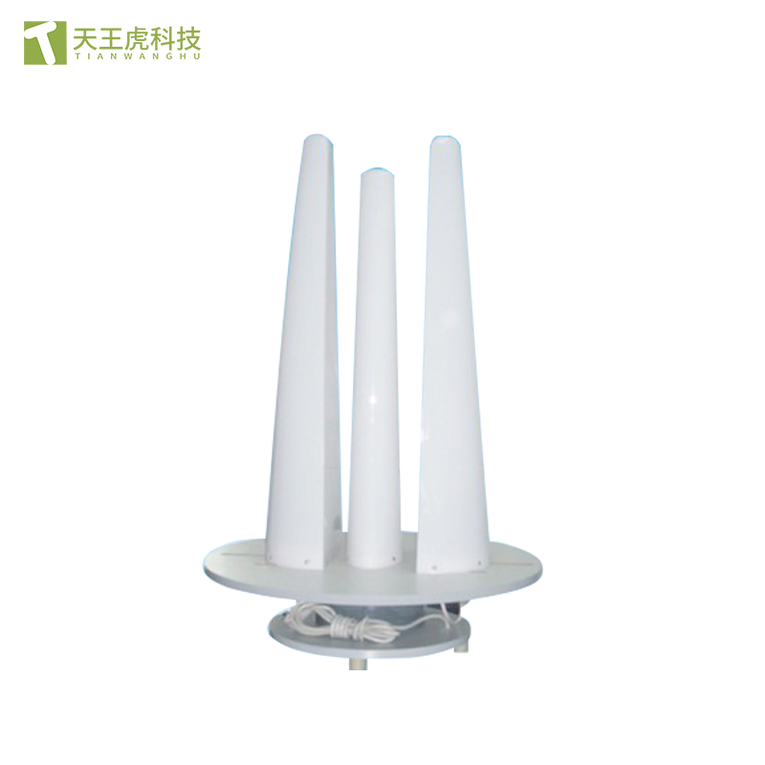
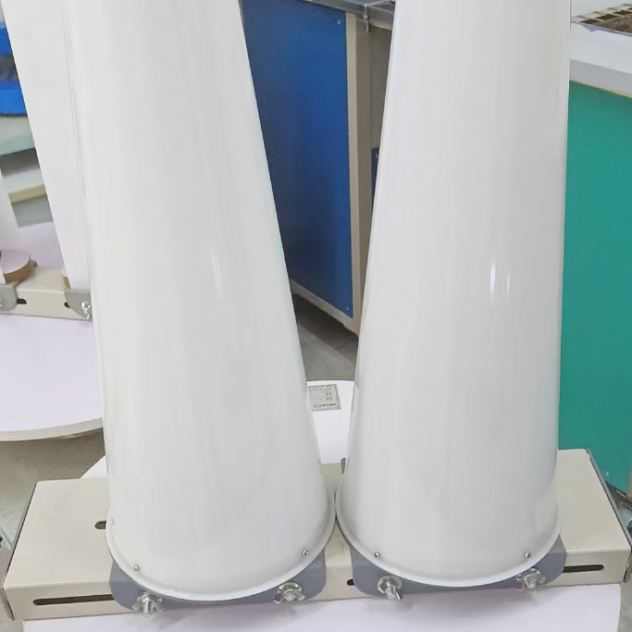
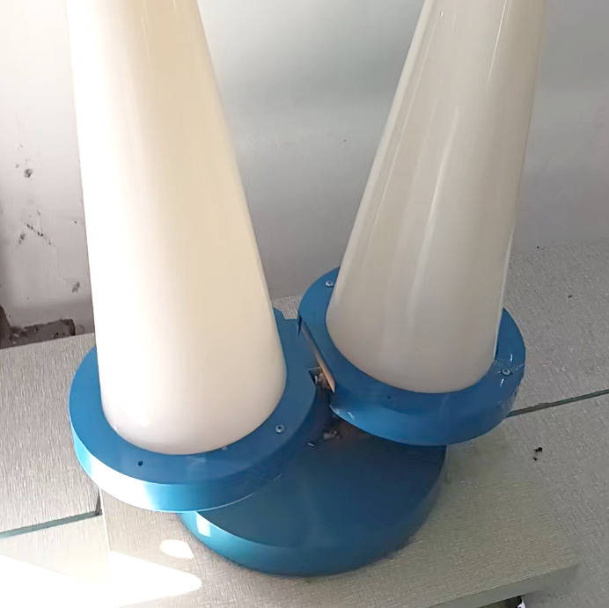
产品11：罩衫灯- Sweater Inspection Lamp
Total height: 35-1/4 inches
Lamp housing height: 26 inches
Lamp holder height: 9-1/4 inches
Lamp holder width: 23-1/2 inches
Lamp holder depth: 23-1/2 inches

